Slide 1
Make SunTrust a better place to work and a better place to bank.

Slide 2
Key Tenants
#StartSmall
#FailFast
#DontMakeThisTooComplicated
#ShootForSwingingDoors

Slide 3

PERMISSION
+ OPPORTUNITIES
+ HERO STORIES
+ PROOF
= CULTURAL CHANGE

Slide 4






A Culture that Fosters Innovation
  People have the freedom to explore ideas that might lead to better products and experiences.
  Leaders have a bias for “now” over “perfect.”
  Getting 50% of the way there for 5% of the cost is worth doing.
  There is a framework for trying, and an appetite for “good failures.”
  Good failures means fast, cheap, low-impact
  There is a robust environment for prototyping,
  testing, and experimentation.
  Easy process for converting worthwhile prototypes into production solutions.

Slide 5
How to build a Minimum Viable Product
Not Like This
Like This

Slide 6
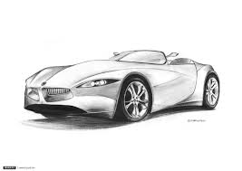
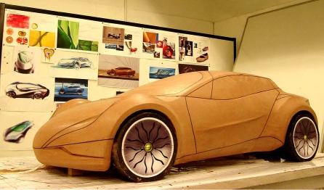
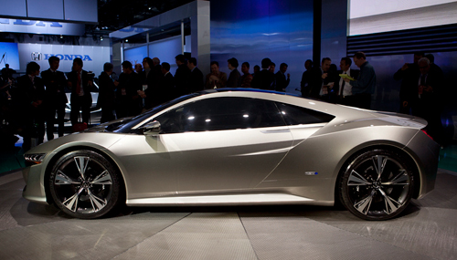
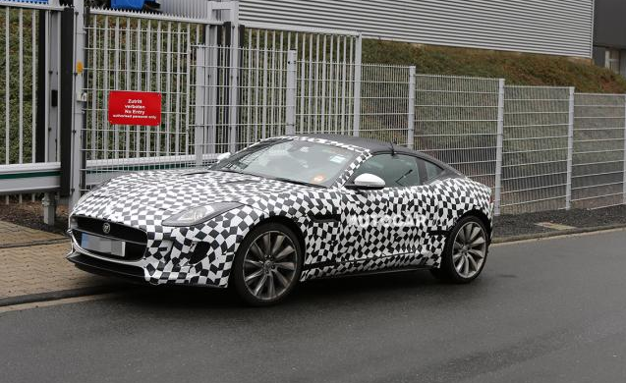
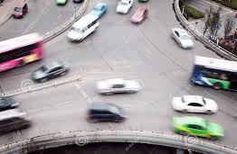
Mockup
Prototype
Proof of Concept
Pilot
Production
It might look like this.
A drawing or PowerPoint demo. This is about look and feel.
Here is a working example of the experience.
This is some coded, working piece. It’s usually a fraction of the full functionality needed.
Yes, this actually works.
A POC will connect to the real systems it needs to function. It can carry real transactions and support a live pilot.
How do real people react?
The pilot is a controlled observation period to figure out what else needs to be done.
It’s live.
Improved and hardened, this baby is ready for primetime. Open it up and make a real impact.
Let’s do this!

Slide 7

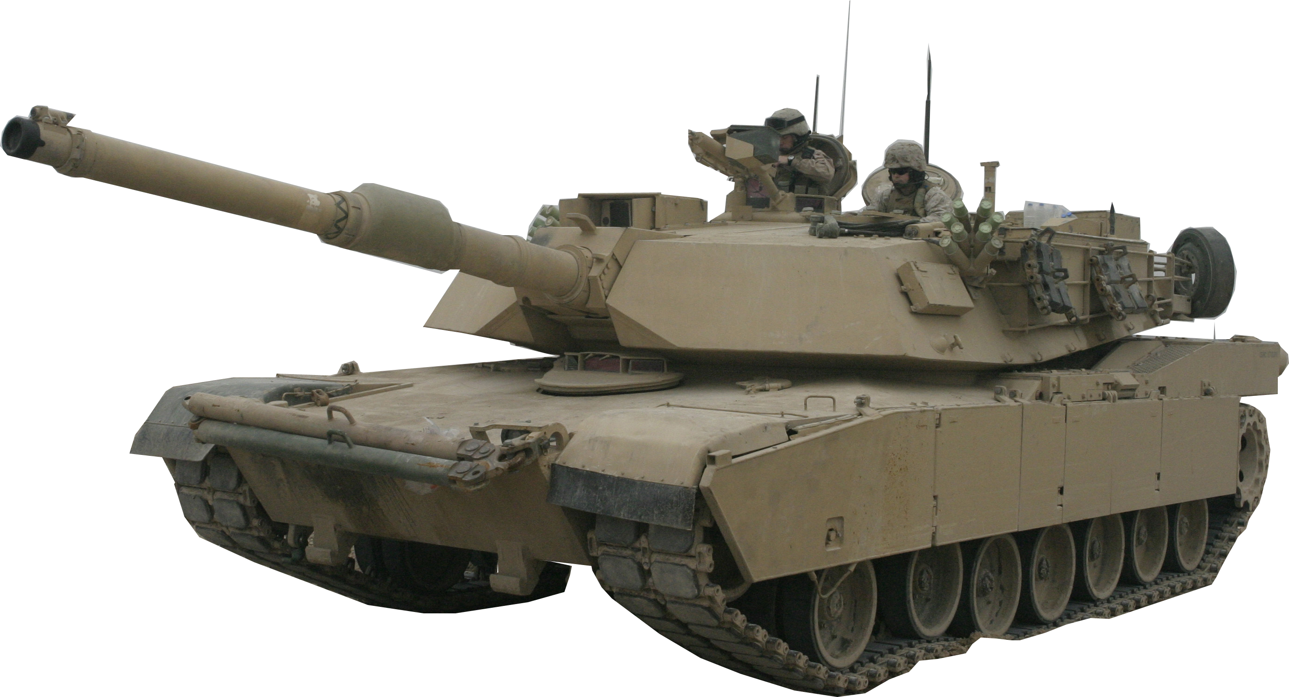

Aim for Swinging Doors
Most opportunities can be classified into three categories:
Rope
Tank
Door
“Pushing on a String” These are fascinating and cool ideas with no real customer demand. Avoid these.
“Pushing on a Tank” These are huge projects where a small team has no way to impact the outcome. Pushing and pulling will not make a meaningful difference. Avoid these.
“Pushing on a Swinging Door” These are projects where there is little resistance and someone is pulling the door on the other side. Find these!

Slide 8
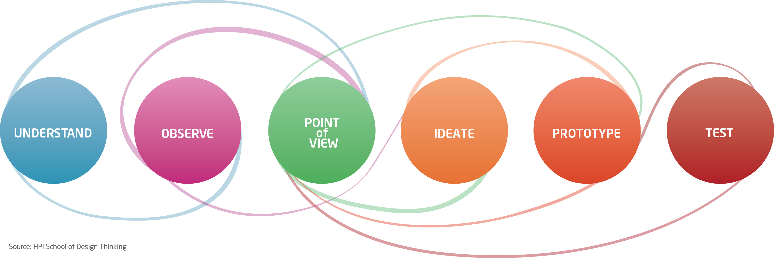
Design Thinking

Slide 9

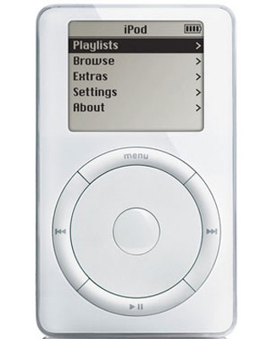
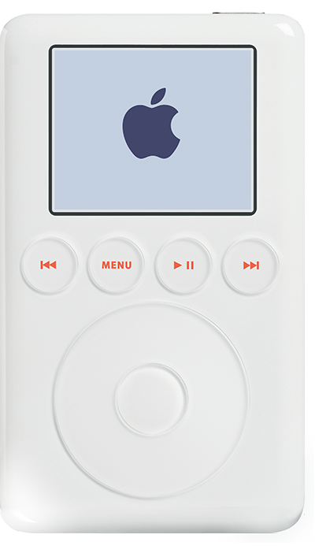
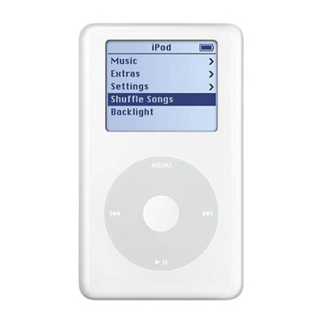
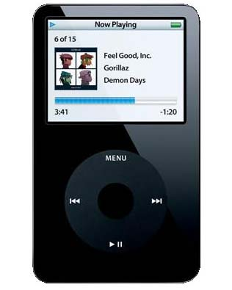

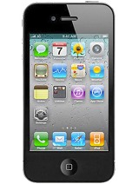
Innovation happens through evolution.
2001 2003 2004 2005 2007 2010 2010
iPod (1st Gen)
iPod (3rd Gen)
iPod (4th Gen)
iPod (5th Gen)
iPhone
iPhone 4
iPad
Notes:
iPod didn’t have a color screen standard until the 5th generation! (iPod Photo and iPod Color existed at 4th Gen)
Evolution of buttons: 6, 6, 2, 2, 1, 1, 1.

Slide 10
Framework for Cultural Change
RULEMAKERS give PERMISSION and incentive
to ACTIVISTS and SUPPORTERS to exhibit model behaviors.
ACTIVISTS work to create OPPORTUNITIES
for SUPPORTERS to become HEROES.
HERO STORIES are shared with
SUPPORTERS and THE CROWD to
give energy to the movement.
Real-world results and evidence
from OUTSIDERS are shared with
SKEPTICS as PROOF that this
cultural movement is the more
valid model for the future.
RULEMAKERS
ACTIVITISTS
HEROES
SUPPORTERS
THE CROWD
SKEPTICS
OUTSIDERS

