Slide 1
7 Ways to Become a Recognized Thought Leader and Linchpin
Notes:
Workshop Thursday May 30 8:30am - 4:30pm
Stop missing out on opportunities to work on better projects or teams, get promoted, or spend more time doing what you love. In this session, we'll help you stand out in a crowd and exploit your uniqueness to improve your opportunities and quality of life at work. We will examine seven patterns and approaches to transform you from a solid task contributor to a recognized solution leader. Learn how to: * Expand your toolbox to deliver new value to your teams * Model desired behaviours and techniques in your target position * Build your professional brand through social platforms and proactive networking
Learning Objectives
Expand your toolbox to deliver new value to your teams
Model desired behaviours and techniques in your target position
Build your professional brand through social platforms and proactive networking
1

Slide 2
Who we are:
Notes:
Leslie and Hans and why you'd want to listen to us. Introduce each other with our perception of their unique value proposition. Compare to our pitch.

Slide 3
Today, we’re talking about…
How to expand your toolbox to deliver new value to your teams.
Model desired behaviours and techniques in your target position
Build your professional brand through social platforms and proactive networking

Slide 4
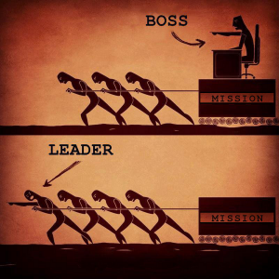
Management vs Leadership
Management:
“Getting the right things done on time” – Dusty Rhoades
HR and/or financial responsibility
“Boss” usually means bad manager
Leadership:
Set the vision and goals
Communicate constraints
Decide how to achieve goals
Align teams to goal and help clear obstacles
Source: http://blog.startwithwhy.com/refocus/2015/07/management-vs-leadership.html
Notes:
What’s the difference between management and leadership?
Define management.
Define leadership.

Slide 5
Leaders vs Managers
Notes:
What do we mean by thought leader and linchpin?
Leaders vs managers. Attributes of a leader.
Principles of Servant leadership.

Slide 6
Why Should I Care About Being a Leader?
More opportunities and career control
Never-ending growth challenges
Increased compensation
Autonomy
Mastery
Purpose
Drive: The Surprising Truth About What Motivates Us by Daniel H. Pink http://www.ted.com/talks/dan_pink_on_motivation
Notes:
Autonomy - The ability for individuals and teams to works to their strengths and super powers.
Master - Learning new skills and knowledge domains.
Purpose - Believing in why you are doing the work or the outcome the work will bring.

Slide 7
What is a Linchpin?
”The linchpin insists on making a difference, on leading, on connecting with others and doing something I call art. The linchpin is the indispensable one, the one the company can’t live without. This is about humanity, not about compliance.”
- Seth Godin
Notes:
What do we mean by thought leader and linchpin?
Leaders vs managers. Attributes of a leader.
Principles of Servant leadership.
Linchpin - Who would you turn to if you needed help to solve a complicated problem? Examples. Image of linchpin with explanation. It's the part of the system that holds critical parts together. Reference Seth Godin "Linchpin".

Slide 8
Communicate to the decision-making level
Source: Karen Pattock, https://www.karenpattock.com/biz-plan-made-simple/strategy-pyramid-business-diagram/
Notes:
Discuss how the perception of value and approach to storytelling must match to the level and audience you are communicating with.

Slide 9
What is Servant Leadership?
Instead of Managing, you are Facilitating.
What does our team need to be successful?
What obstacles need to be cleared?
Wrong:
Right:
“I’m ultimately responsible for delivering the project.”
“I’m responsible for supporting for the team who will achieve our goal.”
Notes:
A manager gets the right things done on time.
A servant leader makes sure the team has the best chance for success and understands what success looks like.

Slide 10
Principles of Servant Leadership
Empathy: Understand and share the feelings of team members and customers. Assume the good with instill loyalty and trust.
Awareness: Care about employees. Be aware how decisions affect others.
Culture: Build a community where employees and customers thrive.
Engage: Collaboration over contract negotiation.
Conceptualization: Focus on the big picture and outcome.
Growth: Care passionately about the personal and professional growth of team members.

Slide 11
Foundation of Servant Leadership
Empower the Team
Collaboration
Accountability
Trust team decisions
Support the Team
Clear obstacles
Secure resources
Protect from interference
Listen to Understand
What is the issue?
What are the options?
What is your recommendation?
Notes:
Empower the Team
Collaboration: “What did ___ think?” Promoting collaboration rather than hierarchy.
Accountability: Help teams understand the impact and cost of missed milestones, don’t blame and shame.
Trust: Team decisions: Example: “3 options and your recommendation”.
Support the Team:
Clear obstacles: Example of finding governance gate champions
Secure resources: Spare laptop example
Free the team from outside interference: Setup anti-aircraft guns against “helicopter managers”
Listen:
Example of meeting where PM gives out info.
Change to actionable meetings: 1. On track/Ready for handoff, 2. Waiting on? 3. Issue: who needs to take offline

Slide 12
7 Ways to Become a Recognized Thought Leader and Linchpin
Understand your value proposition
Lead (not manage)
Make connections/network
Read, relate, quote
Publish or Present
Volunteer
Build your professional toolbox

Slide 13
What are your goals/objectives for this session?
Notes:
Add goals on a sticky sheet and other items on parking lot if we won’t be addressing them in the workshop.

Slide 14
YOUR UNIQUE VALUE PROPOSITION

Slide 15
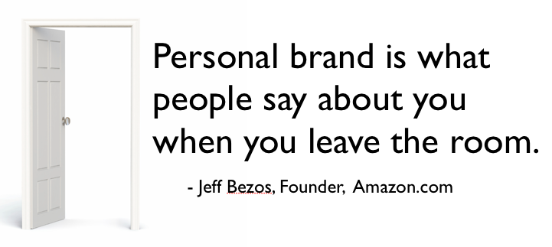
How do people see YOU?
Notes:
Social Media is it’s effectively leveled the corporate playing field when it comes to marketing and advertising.
Think about it for a moment. What’s the first thing you do when you are researching a a person or a brand online?
You likely Google them, right? In fact, there’s a statistic that 94% of the time people Google before they pick up the phone.
How many of you have ever Googled your name?
Have you ever been surprised to see some of your history like your old MySpace page, or posts about your past that you thought were gone forever?
What goes on the Internet, stays on the internet.
As founder of Amazon – Jeff Bezos said “Your personal brand is what people say about you when you leave the room”.
So it’s a little bit about how you position yourself. It’s also how your clients and prospects PERCEIVE you.
You are a brand.
We are all our own media companies. We can use LinkedIn, YouTube, blogging and more to create a presence and build thought leadership.
You no longer have to depend upon traditional media to get your message heard.

Slide 16
Develop your Unique Value Proposition:
A clear statement that describes who you are, what you do, and and what makes you different than everybody else.
I am a _____________________________ (your role)
who helps ___________________ (target audience)
deliver _______________________________ (results)
so they can __________________________ (benefit).
Notes:
For now, I want you to think about your unique VALUE and fill-in-the-blanks.
This is a basic framework to help you get started.
We are going to be diving deep in each of these areas over the next modules but for now I just want you to capture a snapshot of who you are, what you do and who you help.
I am a ___________________________ (your role)
who helps ________________ (target audience)
deliver ______________________________ (results)
so they can ________________________ (benefit)

Slide 17
Why do we buy?
VALUE!
“The amount people will invest with you is directly proportionate to the amount they TRUST you”
- Michael Port
Notes:
Ask the audience for why we buy and challenge the responses until someone says value.
Share story about yard waste bags. You wouldn’t buy the cheapest bag if it always tore.

Slide 18
Uniqueness is your art: Wabi Sabi
Notes:
In traditional Japanese aesthetics, wabi-sabi (侘寂) is a world view centered on the acceptance of transience and imperfection.

Slide 19
Activity: But is it unique? Let’s go deeper!
What are three things you do uncommonly well that an average person doesn’t?
Share with your table.
Share with our group.
Why is this more valuable than basic skills?
Notes:
Promotion/recognition
Awards
Education/Certifications
Years of experience
Core values, passion projects, volunteer work

Slide 20
Activity: Elevator Pitch
Create an elevator pitch you would use if meeting people at a networking event for the first time.
Share your pitch with your table. What did people like? What could be better?
Share your pitch with the group.
Discussion: How might you develop focused pitches for different occasions and groups?
What makes a good pitch?

Slide 21
LEAD (don’t manage)

Slide 22
Discussion: Everyday leaders
What are opportunities to demonstrate leadership every day?
Who are the “blockers” in your teams? How do they approach problems?
What are ways you change a “blocker” approach to being a “problem solvers?

Slide 23
Activity: “Yes, and”
Listening is crucial because you need to be present and in the moment.
Start a conversation with a partner.
You must hear what your partner says, then start with your response with “Yes, and …”.

Slide 24
Discussion: Decision Making
How are decisions made at your organization?
What works and what doesn’t work?

Slide 25
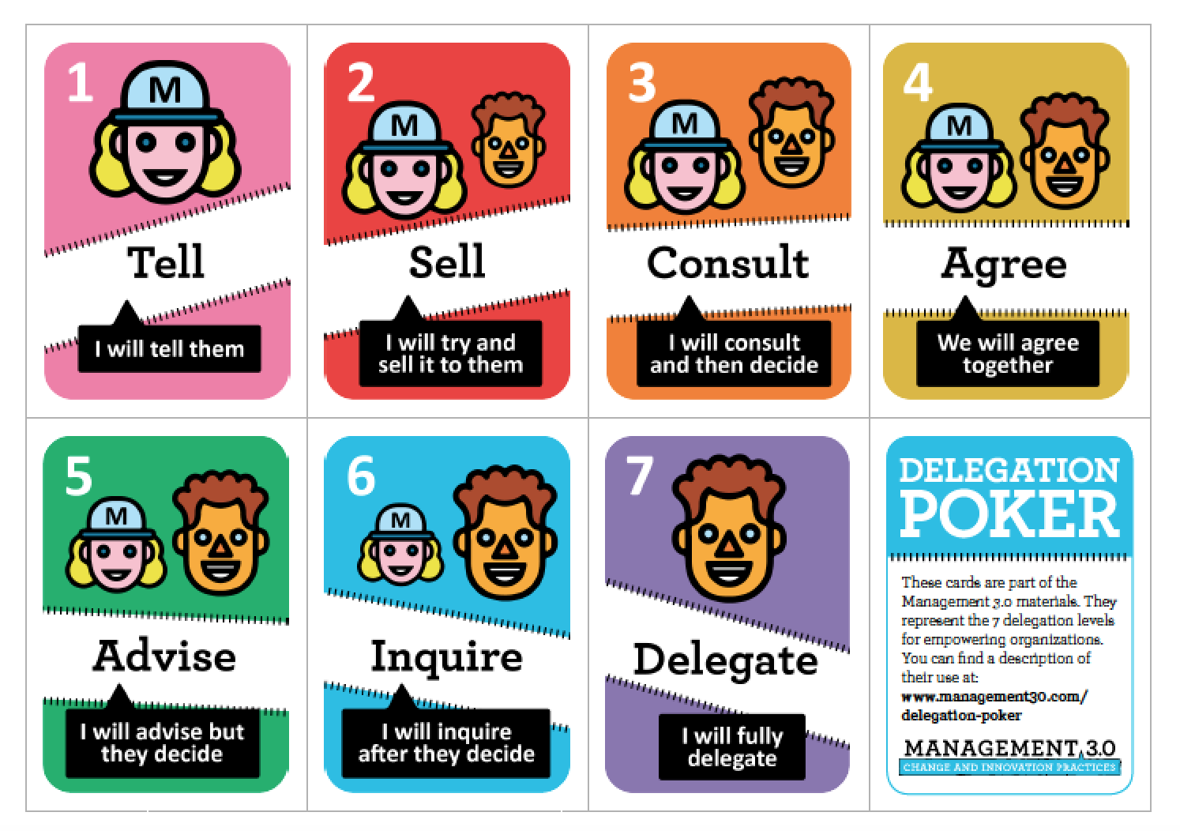
Management 3.0: Delegation Poker
Source: Management 3.0 Delegation Poker: https://management30.com/product/delegation-poker/
Notes:
Run a sample scenario here with the group after describing the decision continuum.
Tell: The manager gives instructions to be followed with no discussion or team input.
Delegate: The manager allows the team full authority to make the decision and does not follow up on what decision they made.
Agree: Manager and team must agree and mutually share the decision. No decision will be made if both parties don’t agree.
Discuss Sell and Consult on the manager side.
Discuss Advise and Inquire on the team side.
Sample Scenarios:
Self-assessments for our annual reviews must be submitted by Friday. (Tell)
Team needs a conference room to use as a war room for the next 3 weeks. (Delegate)
What should we do for our quarterly team building outing? (+/- Agree)

Slide 26
Exercise: Delegation Poker
Divide into teams of 4-6 people.
After hearing the scenario, share your delegation approach.
Discuss the high and low values. Vote again.
As a team, settle on a recommended approach.
Source: Management 3.0 Delegation Poker: https://management30.com/product/delegation-poker/

Slide 27
Exercise: Delegation Poker
Source: Management 3.0 Delegation Poker: https://management30.com/product/delegation-poker/
Notes:
Scenarios:
To meet the project deadline, we’ll need to add resources or have the team work overtime.
Proposed architecture will not work due to constraints on older system versions.
Define team goals for the year.
Prioritize project backlog.
Determine who to hire on the team.
Create new seating plan for team.
Define work intake process.

Slide 28
MAKE CONNECTIONS/NETWORK

Slide 29
Discussion: To be Valued, you need an Audience
Who has ever made a valuable connection with someone new? Where? How?
Have you ever met someone you could help or inform?
Has anyone ever had a job lead from past connections?

Slide 30
Model going from your current self to ideal self
Current Self
Ideal Self
“Everyone fails at who they're supposed to be, Thor. The measure of a person, of a hero, is how well they succeed at being who they are.”
- Frigga, Avengers: Endgame

Slide 31
Model behaviors & techniques
If you aspire to be a leader, look and act like the level of leadership. "Be the change you seek.” ~ Ghandi
If you expect people to speak respectfully to each other, speak respectfully to them.
Model what other successful people have done: What key actions did they take? How did they handle themselves?
Notes:
Psychological modeling is a form of copying or mirroring the behavior of another person. This can be done on a conscious level of awareness, however, we often tend to do this at an unconscious level of awareness during our day-to-day interactions with others.
Employees model the behavior of their managers when it comes to being early for work, leaving late, taking reasonable breaks and seeing projects through to completion.
“Dress” appropriately for the role. Use body language and subconscious cues that showcase authority without dominance.

Slide 32
Reverse-engineering success through modelling
External behavior – habits, responses, words, skills, competence.
Internal states and processes – values, beliefs, emotions etc.
Environment – social circles, trends, support etc.
Not just conscious, but subconscious shift.
Remember, you will employ your own unique ”take” on their success.

Slide 33
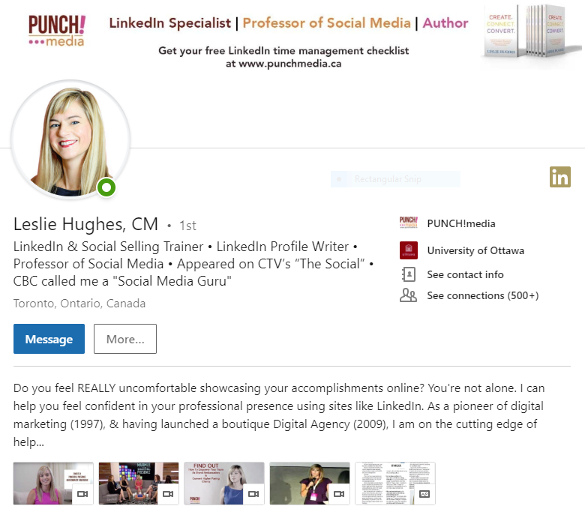
LinkedIn: Making connections for you
Branded Cover Image
Professional Photo
Strong Headline
Compelling Summary
Demonstrate Value
Notes:
Your first impression speaks VOLUMES.
Did you know LinkedIn is one of the highest-ranked brands when someone Googles your name?
Over 600 million members in over 200 countries.
Decision-makers are INVESTING time here
41% of millionaires use LinkedIn / 7 million C-suite, executives etc.
Members have more buying power than other social media sites
277% more effective at converting business than Facebook or Twitter. (Hubpsot)

Slide 34
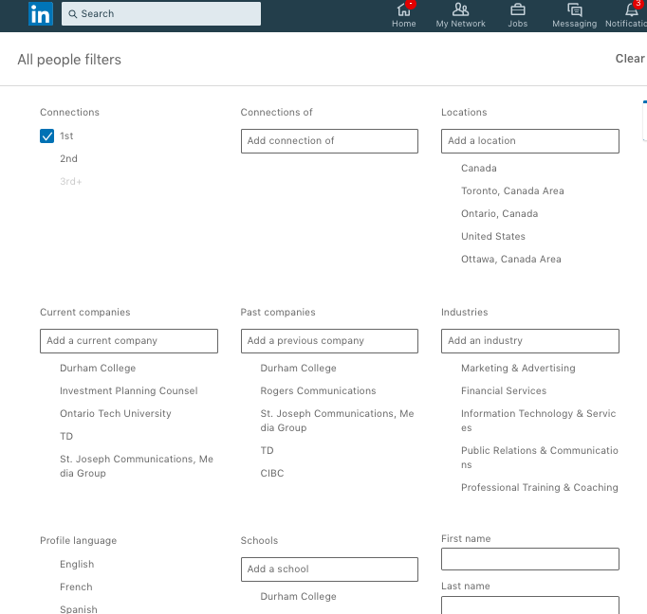
How to make the RIGHT connections for your career.
Your network is your net worth.
Set goals and research your dream connections
Notes:
Did you know 85% of people find jobs through networking?
“Do unto others” is the Golden Rule and it still applies today.

Slide 35
The art of the LinkedIn connection request
Always send a personalized note to remind them how you met: “Hi (name), It was great meeting you at (event). Looking forward to staying in touch here on LinkedIn.”
Offer to connect them with someone in your network, or mutually introduce them to someone you know would be a great connection.
Notes:
Your LinkedIn connections are like your online Rolodex. Continue to add new connections all the time.
After an event.

Slide 36
If you’ve never met them before:
“Hi Sally, I see we both have Deidre Marinelli in common. I used to work with Deidre back when I worked at St. Joseph Publications. I’d love to connect with you here and get to know your business better.”
Or, ask your mutual connection for an introduction.

Slide 37
Building your connections (in person)
Ask someone to introduce you to someone you want to meet.
Set a goal of connecting with a certain number of people per event.
Know that everyone feels just as awkward as you do.
Ask questions about them: What do they like to do in their spare time?
Follow up with a LinkedIn connection request.
PRO TIP: Arrive to a networking even early. This way it’s easier to meet people before they are all paired up.
Notes:
We talked about the fact that LinkedIn is one of the highest ranked sites when someone is looking to see who you are and how you help them.
Whether you’re meeting face-to-face, or reaching out online, making new connections can be challenging and awkward.

Slide 38
Activity: Scavenger Hunt
Find a person who has that experience or could help you solve that problem.
3 points if you connect with them on LinkedIn.
2 points if you get their name and email or phone
1 point if you get their name
Notes:
Activity: Scavenger hunt game.
Each person picks ## task cards.
Find a person who has that experience or could help you solve that problem.
Points: 3 points if you connect with them on Linked In.
2 points if you get their name and email or phone,
1 point if you get their name.
Prize to winning collectors.

Slide 39
READ/RELATE/QUOTE

Slide 40
Do the Wealthy Work Harder Than the Rest?
Source: "The Evolution of Income, Consumption, and Leisure Inequality in The US, 1980-2010" Orazio Attanasio, Erik Hurst, Luigi Pistaferri, NBER Working Paper No. 17982, Issued in April 2012, NBER Program(s):Economic Fluctuations and Growth, https://www.nber.org/papers/w17982
Notes:
Share research study on use of spare time correlated to income.
The income divide isn’t just about education and starting points. It’s about how you choose to use your free time. Do you want to have fun? Relax? Or use the time to make yourself more valuable?

Slide 41
Strengthen your professional brand using Social Media
Accenture’s State of B2B Procurement Study finds that 94% of B2B buyers conduct some degree of research online before making a business purchase, with 55% conducting online research for at least half of their purchases.
Of all executive recruiters, 90% say they conduct online research of potential candidates.
Notes:
Sharing articles and news on social media to strengthen your brand.

Slide 42
Build thought leadership using Social Media
Share relevant, quality content/articles on LinkedIn (status updates)*
Offer to create content for your company blog.
Publish your own blogs or vlogs.
Ensure your digital footprint is optimized.
PRO TIP:
Use Canva.com for images
Check out Grapevine6 for curated content
Purchase stock images or cite source (123RF)
*Make sure you comply with Social Media policies.

Slide 43
Activity: Practice storytelling
In your groups, someone suggest a topic.
At least two people need to share a short story or article reference related to the topic.
Group discussion: How can we tie this into everyday conversations and building your brand?
Notes:
Flash scenarios, someone from each group needs to tell a related story.
Provide feedback on what could have been even better.

Slide 44
PUBLISH and PRESENT

Slide 45
Discussion: Conveying your message to groups
Why does it matter if you can present to groups?
When are you comfortable?
When are you uncomfortable?
Notes:
Importance of being able to convey your message. Examples from group where they have to present or talk to groups. What is comfortable? When does it become uncomfortable?

Slide 46
Hans: The extreme introvert
Notes:
Hans - Share story of being an extreme introvert, forcing myself to join groups and speak publically.

Slide 47
The Power of Introverts: Susan Cain
“There's zero correlation between being
the best talker and having the best ideas.”
“Don't think of introversion as something
that needs to be cured.”
- Susan Cain, Quiet: The Power of Introverts in a World That Can't Stop Talking

Slide 48
Keys to good storytelling
Be concise.
Create an emotional connection.
Find the “What’s in it for me” to the audience.
Notes:
Keys to good story telling.
Concise
Emotional connection
WIIFM to the audience.

Slide 49
Activity: Spy VS Spy
One person share a challenge they recently faced.
2-3 people share a story related to the challenge.
Vote on which story had the greatest impact and value.
Discuss why you connected with that story.
Notes:
Activity: Spy vs Spy with Leslie and Hans. Share a challenge. Trade off telling a related story. Vote on impact.

Slide 50
Finding your unique perspective
Preaching to the choir: To have value, your story must share something we don’t already know.
Good and Bad examples from Leslie and Hans.
Give us a situation.
Notes:
Sharing information everyone knows misses the WIIFM value. Same with something people can't relate to. Examples from Leslie and Hans. Demonstrate how storytelling and value needs to become natural and appear spontaneous

Slide 51
Activity: 2-minute stories
Consider one of your super powers.
Create a short story the illustrates your Unique Value Proposition.
Share with your group.
Notes:
Activity: Come up with a 2-minute story that is important to you. Share with your group. Have a couple people share with everyone.

Slide 52
Volunteer

Slide 53
Volunteer and take calculated risks
Solve problems that don’t have a champion
Help teammates with important or urgent activities
Make your work into a template, example, or reusable asset.
Work with non-profit groups
Your best success stories often come from volunteering

Slide 54
Activity: Solving the unsolved
Identify 3 gaps or opportunities in organizations that don‘t have sponsors.
Groups select one opportunity to work on.
Brainstorm ways you could solve this problem in 8 weeks with no funding.
Share your solution with everyone.
Vote on the solution you’d be willing to work on.

Slide 55
BUILD YOUR PROFESSIONAL TOOLBOX

Slide 56
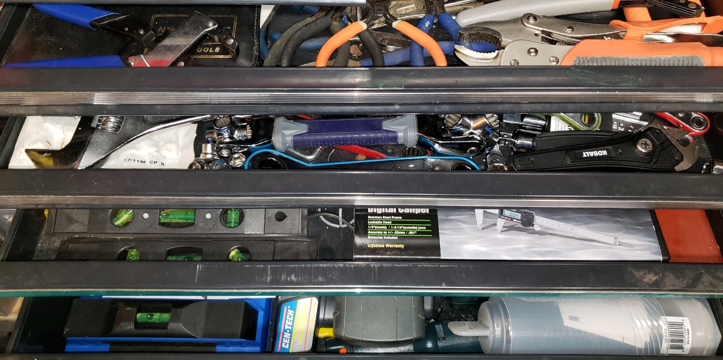
What’s in your professional toolbox?
More ways you learn to solve problems = the more valuable and indispensable you become.

Slide 57
Activity: Strength builder roadmap
On each sticky note, write a tool, strength, or skill that you want or want to improve.
Add a note on where you could get development support.
Add to “Quick Win”, “Short Term” or “Long Term” timeline.
Notes:
Activity: Strengths and gaps. [needs work]
Build your personal development roadmap.
List areas you want to improve or learn.
Add to Quick Win, Short Term, Long term timeline.

Slide 58
Feel confident about your accomplishments
No one else knows what
YOU know from
YOUR perspective.
Source: Dr. Seuss, Happy Birthday to You!
Notes:
Here’s why you need to stand in your value and own your accomplishments.
No one knows what you know from your perspective.
If you don’t stand in your value, you’re actually doing a DISSERVICE to your network.
Everyone wants to work with the BEST. So let yourself shine.

Slide 59
7 Tips to becoming a Thought Leader & Linchpin
Understanding and communicating your UVP.
Take calculated risks.
Delegate.
Make quality connections (online and in person).
Build your professional brand.
Model excellence.
Stand in your value.

Slide 60
Let’s connect
www.linkedin.com/in/hanseckman
www.linkedin.com/in/leslie-hughes

