Slide 1
Improving from the Inside
Creating positive change without authority

Slide 2
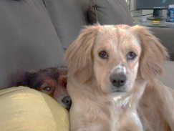
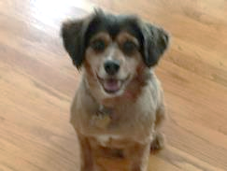
Ground Rules
This session is for you, so please participate.
These are tricks and tips that worked for me but might not be right for everyone or every situation. Please consult a coach or physician to find a program that is best for you.
No animals were harmed during the creation of this presentation, and please support pet rescue groups.
MoeMoe
Oompa
Charlie & Katy
Peanut
Charlie

Slide 3
What are three changes you’d make if you could?
Write down the first changes that come to mind.
So why hasn’t it happened yet?
Photo by Polina Zimmerman

Slide 4
Finding ideas isn’t the problem…
Implementing them is!
Photo by Andrea Piacquadio

Slide 5
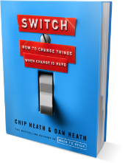
Change requires a two-pronged approach
The Rider
Analytical, adaptable, observant.
Logical connection.
Easily distracted or bored.
The Elephant
Culture, momentum, endurance.
Emotional connection.
Slow to change and adapt.
Switch: How to Change Things When Change Is Hard
Source: Switch by Dan and Chip Heath; Photo by Iurii Laimin:

Slide 6
Motivate the rider and the elephant
The Rider
Sets the direction and goal.
The Elephant
Provides stability and permanence.
Source: Switch by Dan and Chip Heath; Photo by Iurii Laimin:

Slide 7
1. Destination postcards
Describes what success will look like so we know what we are aiming for.
Activity: Take your idea and write a destination postcard.
Source: Switch by Dan and Chip Heath; Photo by Lina Kivaka

Slide 8
2. Script the critical steps
What must happen for you to reach your destination postcard?
Don’t worry about how yet!
Activity: Take your idea and identify critical steps to reach your destination postcard.
Source: Switch by Dan and Chip Heath; Photo by Lina Kivaka

Slide 9
3. Promoting your idea
WIIFM - What’s In It For Me?!!! (or them)
The change must have value to the audience, or they will not fully support it.
Activity:
Who is your primary target audience?
What’s in it for them?
Photo by Carsten Vollrath

Slide 10
4. Build your army of champions
Quantify your impacted audience.
Find thought leaders and change agents.
Align them to your destination postcard and critical steps.
Next, we’ll start to build your army.
Photo by Yan Krukau

Slide 11
Classify your audiences into manageable groups
Indirect Daily Impact
Impacts their overall success
High interest and low impact
High authority
Stakeholders
Influencers
No impact or interest
High authority through position or reputation
Impacts their daily operations
High impact and interest
Low authority
Consumers and End-Users
Controllers
No impact or interest
Enforce policies
Direct Daily Impact

Slide 12
Classify your audiences into manageable groups
Consumers and End-Users
Impacts their daily operations
High impact and interest
Low authority
Stakeholders
Impacts their overall success
High interest and low impact
High authority
Controllers
No impact or interest
Enforce policies
Influencers
No impact or interest
High authority through position or reputation

Slide 13
Techniques: Top-down initiative
Find a leader and make it their idea!
Find champions in positions of authority and/or influence.
Convince them sponsor the solution.
Find change agents to help implement the idea.
Work with them to ensure the integrity of your idea is maintained.
Activity: If this could apply, add it to your idea card.
Photo by August de Richelieu

Slide 14
Techniques: Grassroots/bottom-up
Target users by providing a better way.
Share and spread your idea directly with the end-users who could benefit from the WIIFM.
Make it super easy for more people to use and spread your idea.
Watch for the tipping point, then find the right owner or sponsor to make it official.
Activity: If this could apply, add it to your idea card.
Photo by Tima Miroshnichenko

Slide 15
Techniques: Pain compliance
Make the bad path scary, annoying, and hard.
Pain relivers are more effective than gain creators.
Plan the easy path to use your idea and make it as simple as possible.
Influence or change the current processes to make them as annoying, difficult, and slow as possible.
Activity: If this could apply, add it to your idea card.
Photo by Mizuno K

Slide 16
Techniques: Subversion
Undermine the bad while promoting a better way.
Work to ruin or impede the bad processes or current way of doing things.
Make casual, but not career limiting, comments to draw attention to the inefficiencies.
Suggest your idea to change agents who might champion the idea as their own.
Activity: If this could apply, add it to your idea card.
Photo by Monstera

Slide 17
Finding ideas isn’t the problem…
Implementing them is!
Photo by Andrea Piacquadio

Slide 18
Conclusions
Change must speak to the rider and the elephant.
Start with a Destination Postcard and script the critical steps.
WIIFM - Sell your idea!
Build your army of champions.
Classify your audiences into manageable groups.
Use different techniques until your change happens.
Top-down: Find a champion with authority.
Bottom-up: Promote the change until you find the tipping point.
Pain compliance: Make the bad path scary, annoying, and hard.
Subversion: Undermine the bad while promoting a better way.

Slide 19
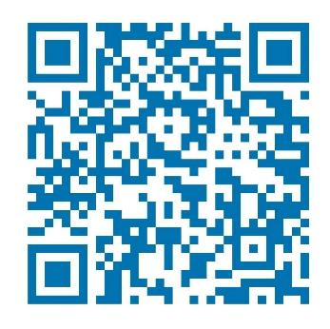
Stay Connected - Phone a Friend!
http://EckmanGuides.com
Hans@HansEckman.com
http://www.linkedin.com/in/hanseckman
https://www.youtube.com/channel/UCVcJ70vc3COPzwFneWL2kqA
https://www.facebook.com/EckmanGuides/
https://twitter.com/hanseckman
Scan for LinkedIn

Slide 21
Consumers and End-Users: Impacts their daily operations. High impact and interest. Low authority.
Stakeholders: Impacts their overall success. High interest and low impact. High authority.
Influencers: No impact or interest. High authority through position or reputation.
Controllers: No impact or interest. Enforce policies.

