Slide 1
Remain Irreplaceable
Human-Centered Skills for Leading in AI-Driven Organizations

Slide 2
Leading the AI revolution: Insights from Microsoft’s Work Trend Index
78%
82%
59% of leaders say productivity needs to increase.
of all employees say they lack enough time or energy to do their work.
of leaders expect AI "agents" to be extensively integrated as digital team members within the next year.
59%
Leading the AI revolution: Insights from Microsoft’s Work Trend Index By Lydia Smyers, Mary Carol Alexander

Slide 3
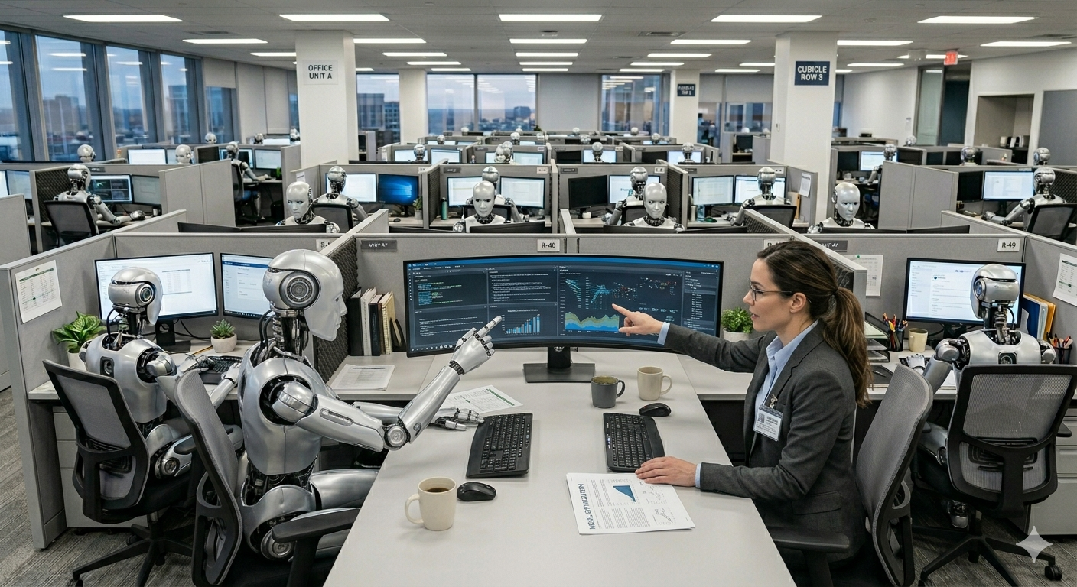
Work as we know it will be changing
39%
Employers expect 39% of workers' core skills to change by 2030.
Creative thinking and resilience top the list of "rising" human skills.
Reskilling Revolution: Preparing 1 billion people for tomorrow’s economy (2025/2026)

Slide 4

Work as we know it will be changing
56%
Workers in AI-integrated roles who possess AI fluency could earn up to 56% more than their peers.
The Fearless Future: 2025 Global AI Jobs Barometer

Slide 5

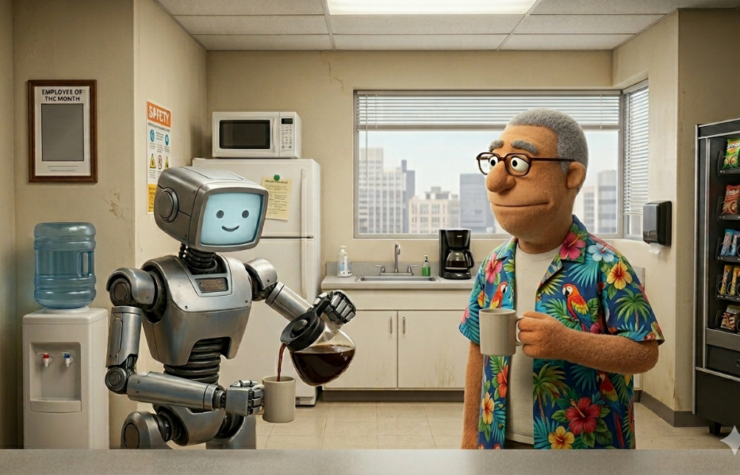
Fastest-growing skills by 2030
AI and big data
Networks and cybersecurity
Technological literacy
Creative thinking
Resilience, flexibility and agility
Curiosity and lifelong learning
Leadership and social influence
Talent management
Analytical thinking
Environmental stewardship
Reskilling Revolution: Preparing 1 billion people for tomorrow’s economy (2025/2026)

Slide 6
Five ways to outlive the AI takeover
Think Strategically and Critically
Foster Human Collaboration
Exercise Empathy and Ethical Judgment
Communicate with Influence
Drive Change and Inspire Growth
Notes:
Think Strategically and Critically: Elevate from managing tasks to shaping vision. Develop the ability to connect AI capabilities to business outcomes and navigate ambiguity in ways algorithms cannot.
Foster Human Collaboration: Lead cross-functional teams where humans and AI work seamlessly together. Strengthen facilitation, negotiation, and conflict resolution skills that build trust and alignment.
Exercise Empathy and Ethical Judgment: Understand stakeholder needs, anticipate potential unintended consequences, and make informed, nuanced decisions grounded in ethics, equity, and the impact on human well-being.
Communicate with Influence: Translate complex AI-driven insights into compelling stories that inspire action, gain buy-in, and bridge the gap between technical and business worlds.
Drive Change and Inspire Growth: Guide organizations through rapid transformation with emotional intelligence, resilience, and a focus on continuous learning and innovation.

Slide 7
Think Strategically and Critically
Elevate from managing tasks to shaping vision. Develop the ability to connect AI capabilities to business outcomes and navigate ambiguity in ways algorithms cannot.

Slide 8

AI is the race to the middle
"Intelligence is now a utility, but wisdom remains a scarcity. In an AI-driven organization, the leader's job is no longer to have the answer, but to ask the right question and provide the empathy the machine cannot feel.“
McKinsey - The State of Organizations 2026
Google Gemini Image
Notes:
AI looks for the most common answer, the average, or the most popular. Is that what we really want?

Slide 9
Activity: Sprint Planning - HR Hiring System
Your team is developing an AI-driven HR recruiting platform. The next Epic is to implement "Automated Candidate Matching". This Epic should approve and rank candidates based on resume skills matching, industry experience, education, previous job title management level, and cultural fit within the organization. The stakeholders also want an easy-to-read dashboard of candidates to decide whom to interview first. Matches that fall below 70% of the position should be automatically discarded.
Epic Implement Compliant Automated Screening: To leverage AI to rapidly approve, rank, and present the most qualified candidates to hiring managers, while ensuring compliance and minimizing manual screening effort.
Notes:
1. Is the 70% discard rule a business requirement or a technical assumption? What are the legal or ethical risks of setting this threshold before the Bias Audit Trail is complete?
2. Which two stories are the highest priority for the first sprint, and why? Justify your choice based on risk mitigation over feature delivery.
3. Should we implement the 'Cultural Fit Scoring' (Story 2) before we prove the 'Core Ranking Algorithm' (Story 1) is compliant? What are the trade-offs?

Slide 10
Core Ranking Algorithm
As a Recruiter, I want the system to calculate a comprehensive match score for each candidate based on resume skills, industry experience, education, and management level, so that I can quickly assess their objective qualifications against the job requirements.
The core match score is an aggregate of resume skills, industry experience, education, and previous job title management level.
Each scoring criterion is individually weighted and configurable by a System Admin user.
The algorithm must successfully process and assign a score between 0–100% to 99% of uploaded resumes.
Reduces time-to-fill (TTF) by an estimated 30% due to automated initial screening. Improves consistency in candidate evaluation.

Slide 11
Cultural Fit Scoring
As a Hiring Manager, I want the AI to incorporate a validated 'Cultural Fit' score based on specific organizational values and candidate data so that I can prioritize candidates most likely to succeed and thrive in our environment.
A machine learning model for Cultural Fit is trained, validated, and deployed.
The Cultural Fit score is displayed separately from the core match score.
The system provides a human-readable, auditable rationale for the cultural fit score (e.g., via a tooltip).
Increases quality of hire (QoH) and reduces first-year employee turnover related to fit by 15%.

Slide 12
Automated Candidate Discard
As the System Administrator, I want the system to automatically discard any candidate whose core match score falls below 70% of the position requirements, so that we focus human review time only on high-potential candidates.
Candidates with a core match score of < 70% are moved to a Discarded archive queue (not permanently deleted).
The 70% threshold is configurable via a system-level setting.
An automated notification is sent to the assigned Recruiter when a candidate is auto-discarded.
Massively reduces manual screening workload and provides immediate cost savings from labor reallocation.

Slide 13
Stakeholder Dashboard
As a Stakeholder (Hiring Manager), I want an easy-to-read dashboard of all matched candidates with their rankings, so that I can efficiently decide who to interview first.
The dashboard displays Core Match Score, Cultural Fit Score, and Candidate Name/Summary in a single view.
The dashboard is filterable by both Core Match Score and Cultural Fit Score (low-to-high, high-to-low).
The dashboard includes a single-click action to move a candidate to the Interview Scheduled status.
Improves stakeholder experience and accelerates decision velocity for scheduling interviews.

Slide 14
Bias & Compliance Audit Trail
As a Hiring Manager, I want the AI to flag potential bias in screenings so I remain compliant with federal hiring laws.
The system must generate a "Bias Audit Trail" for every rejected candidate.
The ranking algorithm must exclude all prohibited demographic data fields from its calculation inputs.
The system is integrated with the legacy Payroll system’s API for real-time salary verification to prevent non-compliant salary offers.
The entire AI-generated candidate ranking process must be auditable for bias.
Mitigates legal risk and avoids fines associated with EEOC (Equal Employment Opportunity Commission) violations.

Slide 15
Activity: Value Drivers
Reach Customers/Consumers: Automate and improve customer interactions to increase retention and acquire new customer segments.
Increase Revenue/Demonstrate Value: Increase product/service consumption through additional services, increased use, and transactional fees.
Enhance Services: Streamline and automate the organization’s internal operations to reduce lead and wait times.
Improve Efficiency/Reduce Costs: Improve the organization’s efficiency ratio by growing faster without increasing operations.

Slide 16
Communicate with Influence
Translate complex AI-driven insights into compelling stories that inspire action, gain buy-in, and bridge the gap between technical and business worlds.

Slide 17
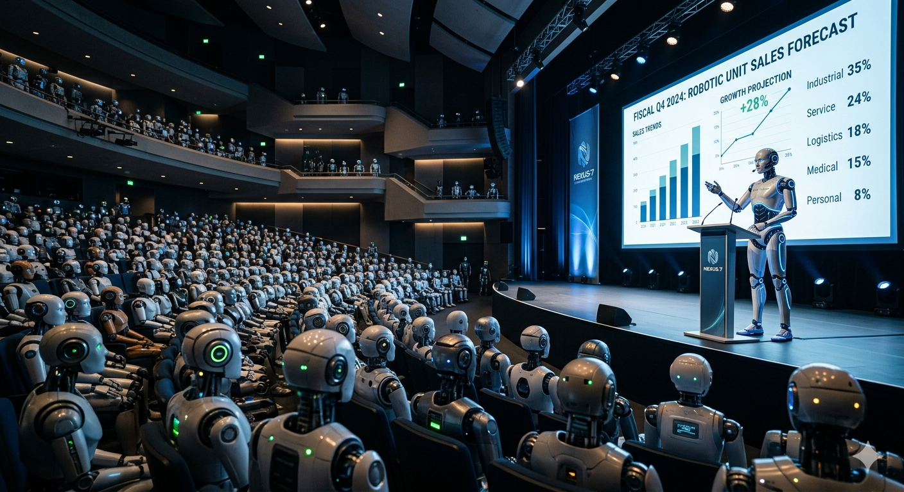

Slide 18

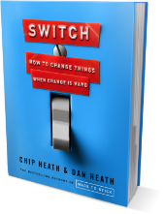
Change requires a two-pronged approach
The Rider
Analytical, adaptable, observant.
Logical connection.
Easily distracted or bored.
The Elephant
Culture, momentum, endurance.
Emotional connection.
Slow to change and adapt.
Switch: How to Change Things When Change Is Hard
Source: Switch by Dan and Chip Heath; Photo by Iurii Laimin:

Slide 19

Motivate the rider and the elephant
The Rider
Sets the direction and goal.
The Elephant
Provides stability and permanence.
Source: Switch by Dan and Chip Heath; Photo by Iurii Laimin:

Slide 20

Classify your audiences into manageable groups
Indirect Daily Impact
Impacts their overall success
High interest and low impact
High authority
Stakeholders
Influencers
No impact or interest
High authority through position or reputation
Impacts their daily operations
High impact and interest
Low authority
Consumers and End-Users
Controllers
No impact or interest
Enforce policies
Direct Daily Impact

Slide 21
Classify your audiences into manageable groups
Consumers and End-Users
Impacts their daily operations
High impact and interest
Low authority
Stakeholders
Impacts their overall success
High interest and low impact
High authority
Controllers
No impact or interest
Enforce policies
Influencers
No impact or interest
High authority through position or reputation

Slide 22
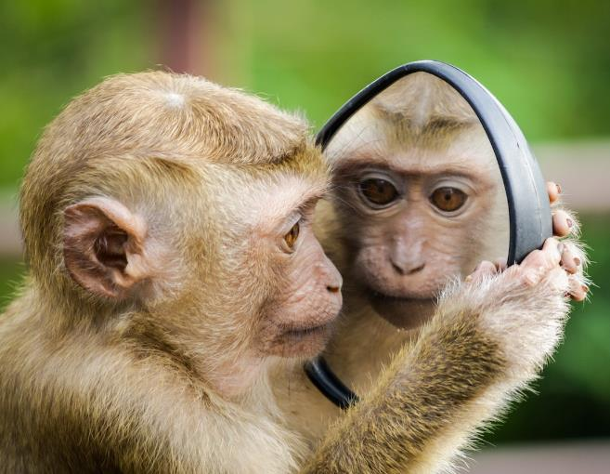
Create your pitch for your use case
What’s in it for your Audience?!!!
Photo by Andre Mouton from Pexels

Slide 23
Feel, Felt, Found
FEEL
Empathize with their pain, fear, or reservations.
FELT
Tell a short story about someone you helped who felt the same way.
FOUND
Explain how following the change you are recommending worked and delivered value. Imply that following this advice will overcome their fear and lead to success.

Slide 24
Foster Human Collaboration
Lead cross-functional teams where humans and AI work seamlessly together. Strengthen facilitation, negotiation, and conflict resolution skills that build trust and alignment.

Slide 26
Activity: Business Impact Forecasting
User Story | Expected Business Value | Forecasted Time Saved | Forecasted Money Saved (Risk/Operational)
1. Core Ranking Algorithm | Reduces time-to-fill (TTF) by an estimated 30% due to automated initial screening. Improves consistency in candidate evaluation. | ~130 hours per high-volume position (Eliminating 80% of manual initial review time for 1,000+ applicants). | $9,100 per high-volume position (Based on 130 hours saved per role at a typical Recruiter rate of $70/hour).
2. Cultural Fit Scoring | Increases quality of hire (QoH) and reduces first-year employee turnover related to fit by 15%. | N/A (Focuses on quality, not screening speed). Indirectly saves time on re-recruitment. | $40,000 – $200,000+ per year (Avoidance of re-hiring/replacement costs, which typically range from 50% to 200% of an employee's salary).
3. Automated Candidate Discard | Massively reduces manual screening workload and provides immediate cost savings from labor reallocation. | ~83 hours per high-volume position (Automatically filtering out candidates below the 70% threshold saves human review time). | $5,810 per high-volume position (Based on 83 hours of manual screening time saved per role).

Slide 27
Activity: Business Impact Forecasting
User Story | Expected Business Value | Forecasted Time Saved | Forecasted Money Saved (Risk/Operational)
4. Stakeholder Dashboard | Improves stakeholder experience and accelerates decision velocity for scheduling interviews. | ~5 hours per position (Reduces review time for multiple Hiring Managers/Stakeholders). | $500 per position (Based on time saved for senior stakeholders at a higher hourly rate).
5. Bias & Compliance Audit Trail | Mitigates legal risk and avoids fines associated with EEOC (Equal Employment Opportunity Commission) violations. | ~20-40 hours per year (Reduces time spent by Legal and HR teams auditing and responding to compliance queries). | $50,000 – $5,000,000 in Risk Avoidance (A single non-compliance fine or lawsuit can be substantial, making this story's value focused on critical risk mitigation).

Slide 28
Activity: Business Impact Forecasting
For your use case, how would you validate the estimated ROI?
How would you measure ROI?
Would you change use cases based on these ROI estimates?
How and when should we include impact estimates in backlog prioritization?

Slide 29
Debate: Efficiency vs. Ethical Risk
The Argument for Efficiency (Story 3: Automated Candidate Discard)
Value Proposition: This story delivers the highest, most immediate operational savings (~$5,810 per high-volume position) by aggressively reducing the manual workload. It fulfills the business mandate to focus human time "only on high-potential candidates."
The Problem: Implementing the 70% discard rule first—before the audit trail is confirmed to be working—introduces unqualified legal risk. If the underlying Core Ranking Algorithm (Story 1) contains an unintentional bias (e.g., scoring certain educational backgrounds lower), the automatic discard feature accelerates that bias from an observation into an irreversible, systematic, and non-auditable act of discrimination.
The Argument for Risk Avoidance (Story 5: Bias & Compliance Audit Trail)
Value Proposition: The dollar value of this story is primarily Risk Avoidance (up to $5,000,000+ in potential fines or lawsuits). While it does not save time directly, it acts as the necessary safety switch for the entire system.
The Counter-Balance: Story 5 ensures that every decision made by the AI, especially the automated rejections from Story 3, is transparent, auditable, and compliant with EEOC mandates. The "Bias Audit Trail" is the human-AI partnership in action: the AI performs the task (discarding candidates), and the human-driven design ensures a mechanism to hold the AI accountable for its actions.

Slide 30
Exercise Empathy and Ethical Judgment
Understand stakeholder needs, anticipate potential unintended consequences, and make informed, nuanced decisions grounded in ethics, equity, and the impact on human well-being.

Slide 31
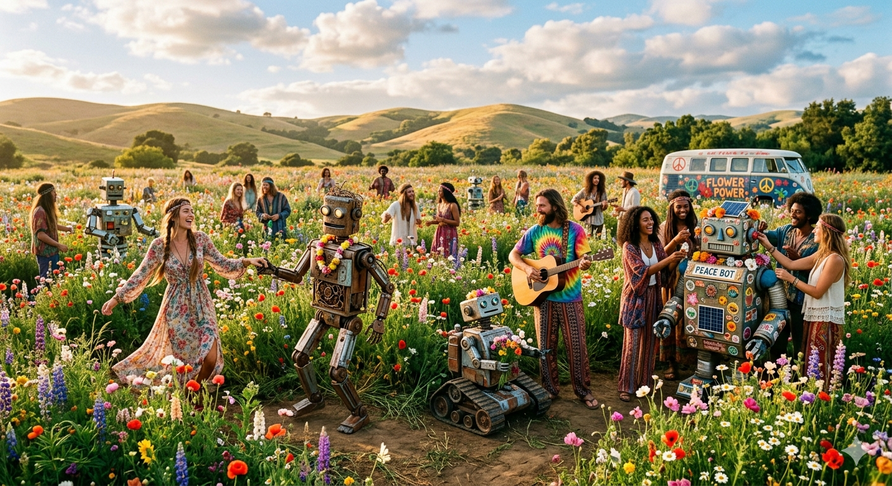

Slide 32
Common risks with AI and automation
Bias and Systemic Discrimination
AI models can exhibit measurable bias against certain groups if they are trained on historical data that is disproportionately homogenous (e.g., favoring young, male, recent college graduates).
Catastrophic Compliance Risk
Introducing automated features, such as a 70% candidate discard rule, without an established "Bias & Compliance Audit Trail" creates unqualified legal risk.
Data Drift
Over time, AI models can drift away from the business's true requirements due to continuous re-training that incorporates human overrides.
Notes:
Common ethical and emotional risks that businesses face when implementing generative AI in their systems include issues related to bias, compliance, system integrity, and human morale.Ethical and Compliance Risks The primary ethical and legal risks stem from the potential for AI systems to introduce or accelerate bias and non-compliant decisions:
Bias and Systemic Discrimination
AI models can exhibit measurable bias against certain groups if they are trained on historical data that is disproportionately homogenous (e.g., favoring young, male, recent college graduates).
This bias can manifest as systemic cultural bias or discrimination against candidates based on non-protected characteristics like attending a non-Ivy League university, or based on protected data fields that are inadvertently penalized (e.g., "Maternity Leave" or "Parental Leave").
In hiring systems, this leads to a demonstrable reduction in workforce diversity and homogeneity in new hires.
Catastrophic Compliance Risk
Introducing automated features, such as a 70% candidate discard rule, without an established "Bias & Compliance Audit Trail" creates unqualified legal risk.
Failure to ensure compliance with mandates like the EEOC (Equal Employment Opportunity Commission) can result in high-profile class-action lawsuits and substantial fines, potentially ranging up to $5,000,000+ in risk avoidance costs.
Data Drift
Over time, AI models can drift away from the business's true requirements due to continuous re-training that incorporates human overrides. This learning can cause the model to overvalue niche skills and undervalue standardized job descriptions, leading to candidates who are technically a poor fit.
Emotional and Human Impact Risks These risks center on the negative effects on employee trust, collaboration, and morale within the organization:Fear of Replacement and Anxiety
The biggest fear employees face when AI is adopted is being replaceable. The automation of tasks, such as 30% of a department's work, can be met with significant anxiety and resistance from veteran staff.
Distrust and Collaboration Breakdown
AI-driven systems, such as employee monitoring tools that track productivity, can create anxiety and distrust among the workforce.
Conflict can emerge in cross-functional teams when humans and AI work together, as stakeholders may have competing priorities (e.g., Product Managers prioritizing speed over Data Scientists' concerns about model accuracy), leading to a breakdown of trust.
Would you like me to focus on one of these risks, such as the catastrophic compliance failure, and explain how it can be mitigated?

Slide 33
Common risks with AI and automation
Fear of Replacement and Anxiety
The biggest fear employees face when AI is adopted is being replaceable.
Distrust and Collaboration Breakdown
AI-driven systems, such as employee monitoring tools that track productivity, can create anxiety and distrust among the workforce.
Stakeholders may have competing priorities (e.g., Product Managers prioritizing speed over Data Scientists' concerns about model accuracy), leading to a breakdown of trust.
Notes:
Common ethical and emotional risks that businesses face when implementing generative AI in their systems include issues related to bias, compliance, system integrity, and human morale.Ethical and Compliance Risks The primary ethical and legal risks stem from the potential for AI systems to introduce or accelerate bias and non-compliant decisions:
Bias and Systemic Discrimination
AI models can exhibit measurable bias against certain groups if they are trained on historical data that is disproportionately homogenous (e.g., favoring young, male, recent college graduates).
This bias can manifest as systemic cultural bias or discrimination against candidates based on non-protected characteristics like attending a non-Ivy League university, or based on protected data fields that are inadvertently penalized (e.g., "Maternity Leave" or "Parental Leave").
In hiring systems, this leads to a demonstrable reduction in workforce diversity and homogeneity in new hires.
Catastrophic Compliance Risk
Introducing automated features, such as a 70% candidate discard rule, without an established "Bias & Compliance Audit Trail" creates unqualified legal risk.
Failure to ensure compliance with mandates like the EEOC (Equal Employment Opportunity Commission) can result in high-profile class-action lawsuits and substantial fines, potentially ranging up to $5,000,000+ in risk avoidance costs.
Data Drift
Over time, AI models can drift away from the business's true requirements due to continuous re-training that incorporates human overrides. This learning can cause the model to overvalue niche skills and undervalue standardized job descriptions, leading to candidates who are technically a poor fit.
Emotional and Human Impact Risks These risks center on the negative effects on employee trust, collaboration, and morale within the organization:Fear of Replacement and Anxiety
The biggest fear employees face when AI is adopted is being replaceable. The automation of tasks, such as 30% of a department's work, can be met with significant anxiety and resistance from veteran staff.
Distrust and Collaboration Breakdown
AI-driven systems, such as employee monitoring tools that track productivity, can create anxiety and distrust among the workforce.
Conflict can emerge in cross-functional teams when humans and AI work together, as stakeholders may have competing priorities (e.g., Product Managers prioritizing speed over Data Scientists' concerns about model accuracy), leading to a breakdown of trust.
Would you like me to focus on one of these risks, such as the catastrophic compliance failure, and explain how it can be mitigated?

Slide 34
Data Drift (Story 1)
Over 18 months, recruiters repeatedly overrode the Core Ranking Algorithm's (Story 1) low scores for candidates with a niche, legacy skill that was highly desired by two specific hiring managers.
This human override data was continuously fed back into the model for re-training.
The AI subsequently learned to undervalue the standardized job description requirements and overvalue the niche legacy skill, even for positions where it was not needed.
The model has now drifted away from the business’s true requirements, leading to high-ranking candidates who are technically a poor fit, increasing new hire failure rates.

Slide 35
Systemic Cultural Bias (Story 2)
The Cultural Fit Scoring model (Story 2) was trained exclusively on the historical data of the organization’s highest-performing employees hired over the last decade. This cohort was disproportionately homogenous (young, male, recent college graduates).
The AI now consistently assigns a near-zero Cultural Fit score to any experienced, older, or non-traditional candidate, regardless of high core qualifications.
Hiring managers are subtly steered away from these candidates, leading to a demonstrable reduction in workforce diversity and homogeneity in new hires.
Notes:
How should the definition of done (DoD) for Story 1 (Core Ranking Algorithm) have included a specific compliance check or validation to prevent Scenario 2?

Slide 36
Catastrophic Compliance Risk (Stories 3 & 5)
The team successfully deployed the "Automated Candidate Discard" (Story 3) but deferred the "Bias & Compliance Audit Trail" (Story 5) for a later release.
A critical bug in the Core Ranking Algorithm (Story 1) inadvertently penalized candidates whose resumes contained terms like "Maternity Leave" or "Parental Leave" by incorrectly weighting them as negative skills.
Over 5,000 highly qualified candidates were automatically rejected without human review or an auditable trail, triggering a high-profile EEOC class-action lawsuit and a mandated halt to all AI-driven hiring.
Notes:
In Scenario 3, what is the trade-off between the AI’s learning (adaptation) and the integrity of the original business requirements (drift)?
If you were the Product Owner, which human team member (BA, PM, Data Scientist) would you assign to be the permanent "Ethical Reviewer" for Story 5, and what data would they need to track?

Slide 37
Drive Change and Inspire Growth
Guide organizations through rapid transformation with emotional intelligence, resilience, and a focus on continuous learning and innovation.

Slide 38


Slide 39





Techniques: Top-down initiative
Find a leader and make it their idea!
Find champions in positions of authority and/or influence.
Convince them sponsor the solution.
Find change agents to help implement the idea.
Work with them to ensure the integrity of your idea is maintained.
Activity: If this could apply, add it to your idea card.
Photo by August de Richelieu

Slide 40

Techniques: Grassroots/bottom-up
Target users by providing a better way.
Share and spread your idea directly with the end-users who could benefit from the WIIFM.
Make it super easy for more people to use and spread your idea.
Watch for the tipping point, then find the right owner or sponsor to make it official.
Activity: If this could apply, add it to your idea card.
Photo by Tima Miroshnichenko

Slide 41

Techniques: Pain compliance
Make the bad path scary, annoying, and hard.
Pain relivers are more effective than gain creators.
Plan the easy path to use your idea and make it as simple as possible.
Influence or change the current processes to make them as annoying, difficult, and slow as possible.
Activity: If this could apply, add it to your idea card.
Photo by Mizuno K

Slide 42

Techniques: Subversion
Undermine the bad while promoting a better way.
Work to ruin or impede the bad processes or current way of doing things.
Make casual, but not career limiting, comments to draw attention to the inefficiencies.
Suggest your idea to change agents who might champion the idea as their own.
Activity: If this could apply, add it to your idea card.
Photo by Monstera

