Slide 1
Building Emotional Fitness to Lead During Difficult Times
Hans Eckman | EckmanGuides.com | @HansEckman
http://www.linkedin.com/in/hanseckman

Slide 2

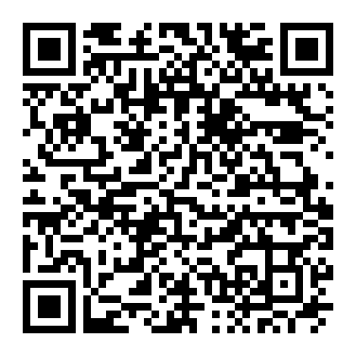
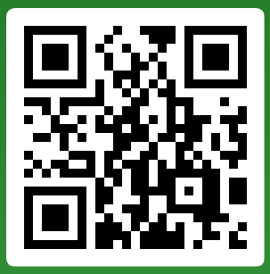
Downloads
EckmanGuides.com
  Free access to all presentations, interviews, podcasts, and articles
Join our live polling:
SLIDO.COM
Event code: 224733
Or scan the QR code.
Join from your web browser, phone, or tablet to participate. First 100 people only, because I’m too cheap to pay for the premium service.
Scan to join
SLIDO polls

Slide 3
Disclaimer and mental health resources
I’m not a doctor, psychologist, or licensed counselor.
These are lessons I’ve learned in life and the resources cited.
Strength is seeking help. Please take advantage of professional resources:
  Immediate Help (Crisis): Call or text 988 for the Crisis Lifeline (24/7).
  Mental Health Directories: SAMHSA Behavioral Health Treatment Services Locator or the NIMH Help for Mental Illnesses.
  NAMI (National Alliance on Mental Illness): Free support and education.
  HelpGuide.org: Nonprofit provider of quality health information
  Insurance & Providers: Contact your insurer to find in-network providers.
  Low-Cost Options: Mental Health America's Finding Help.

Slide 4
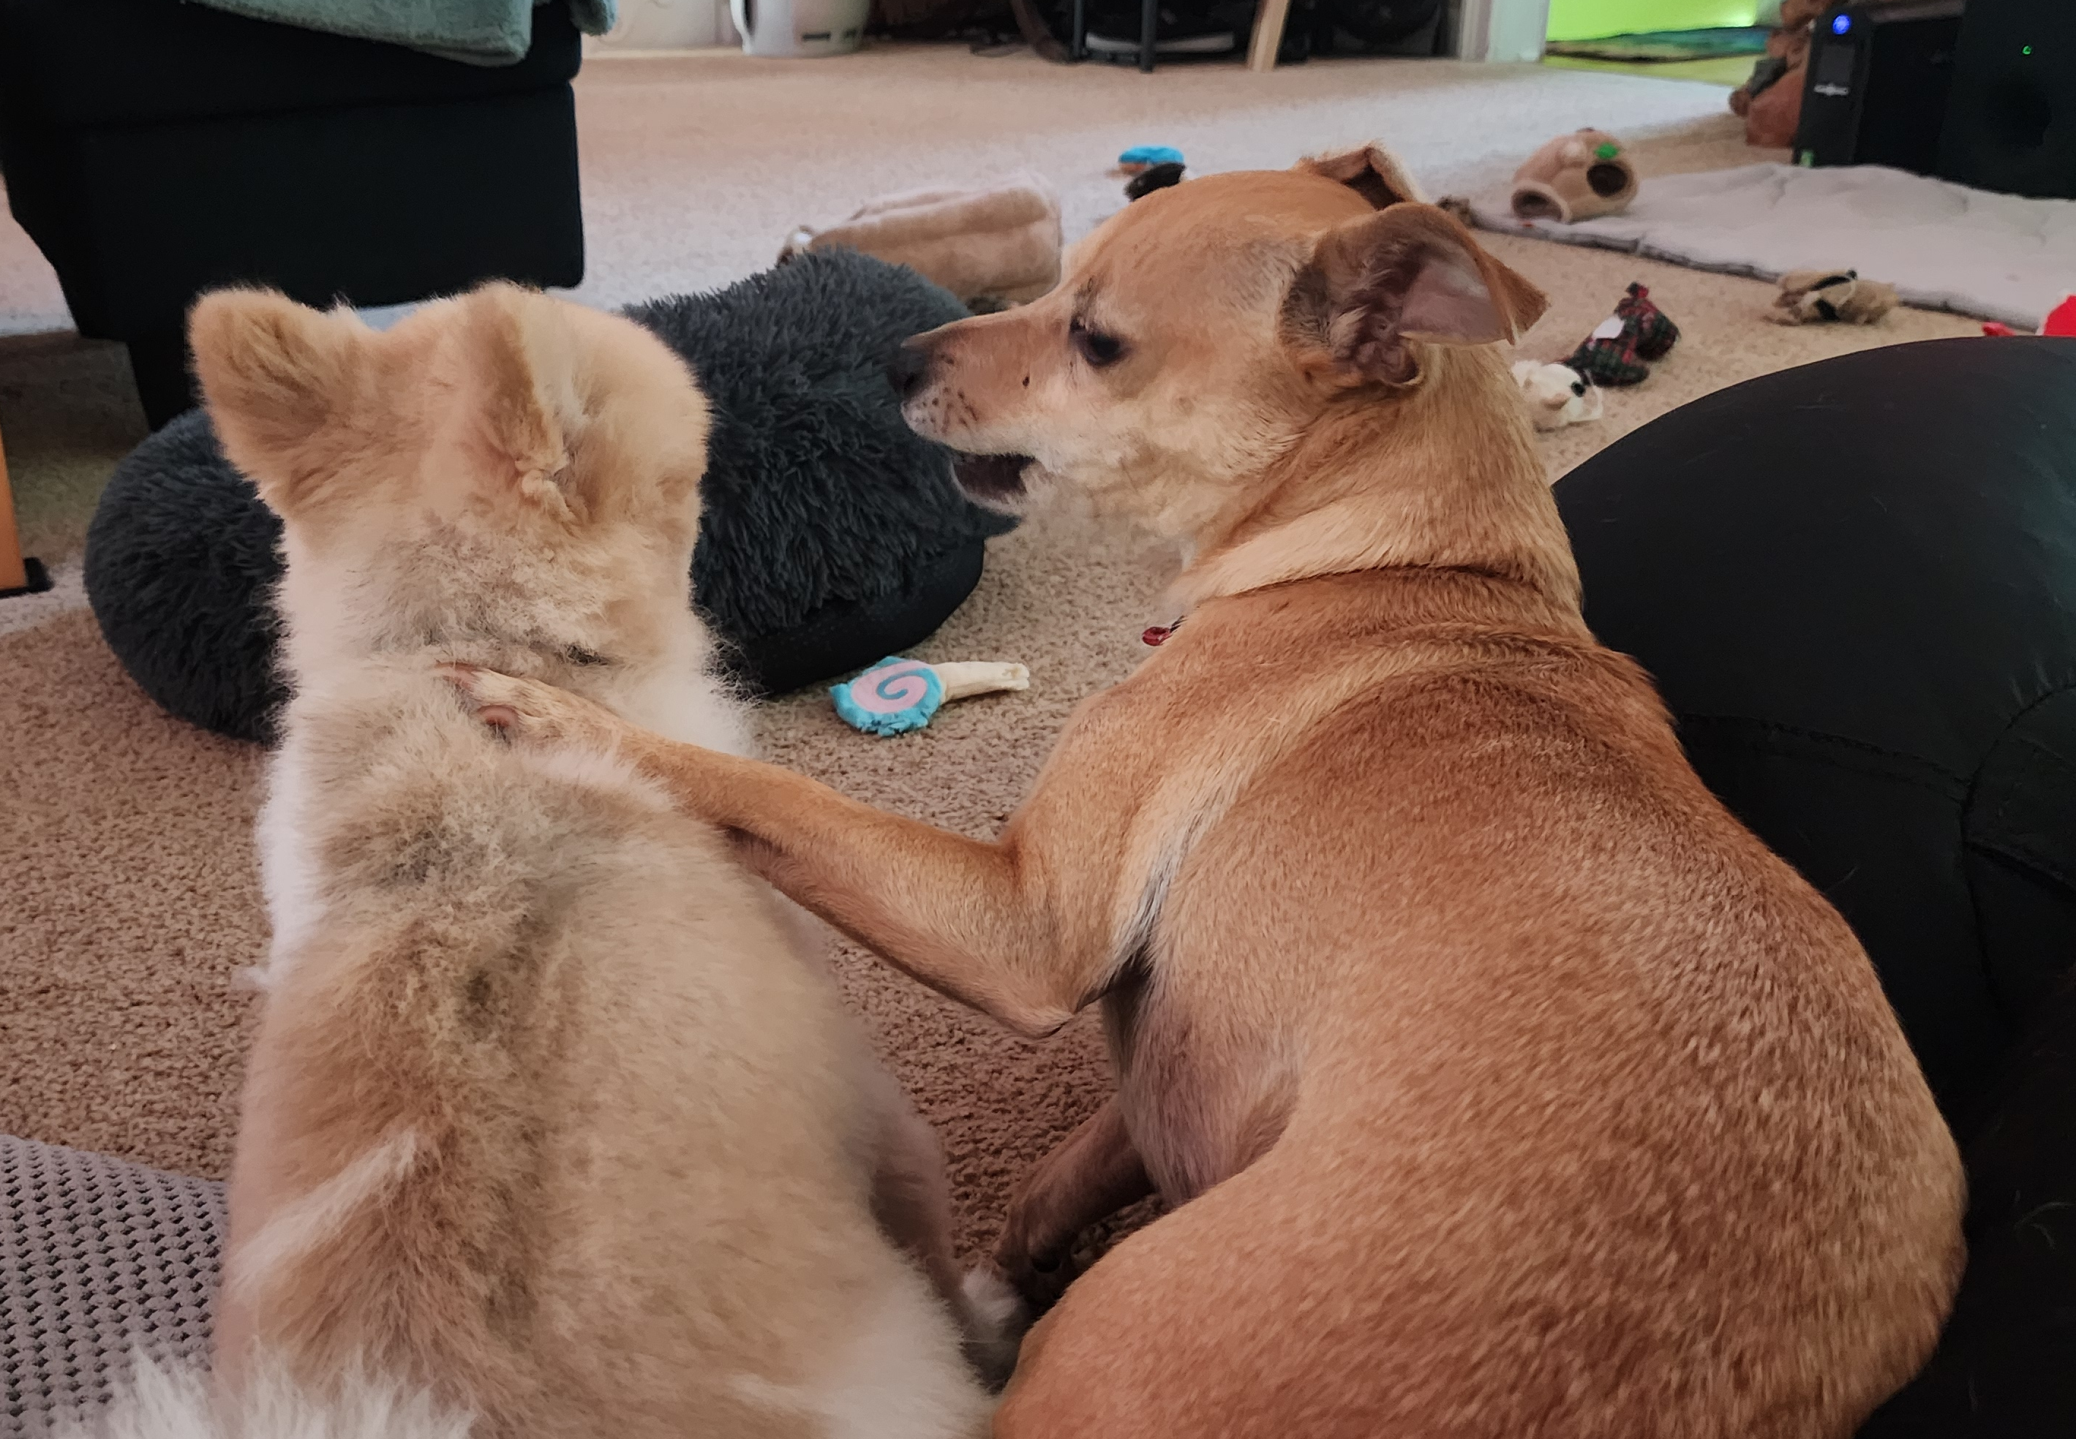
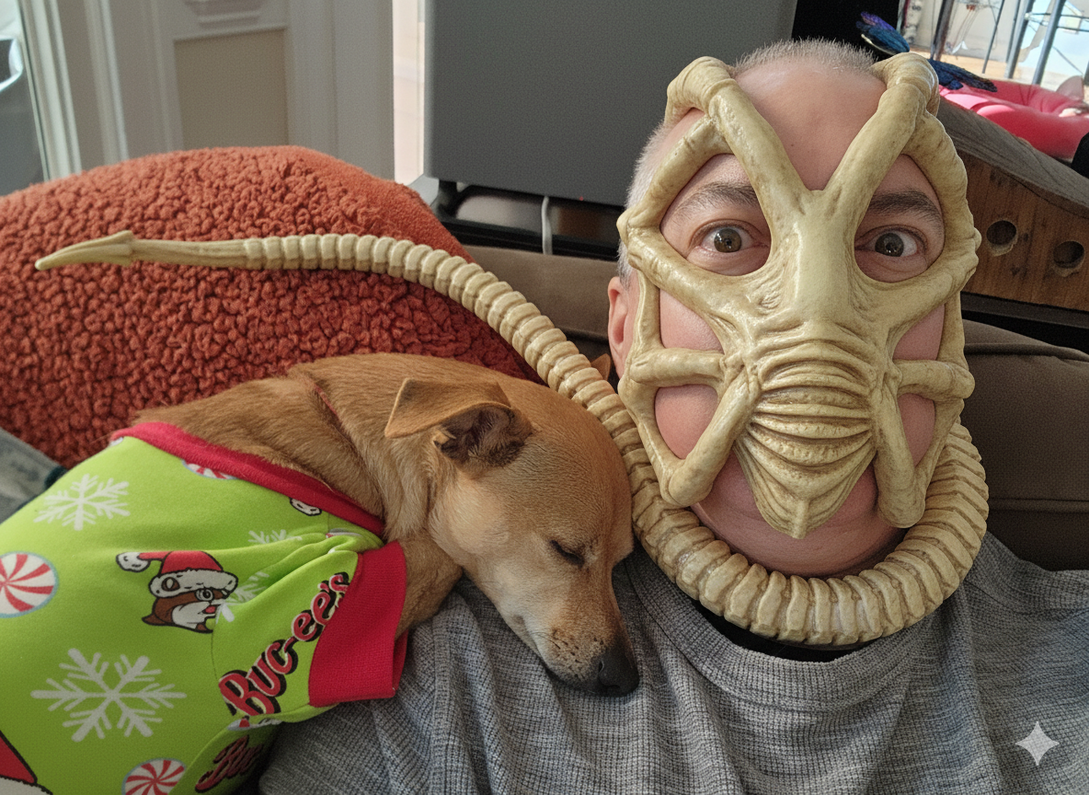
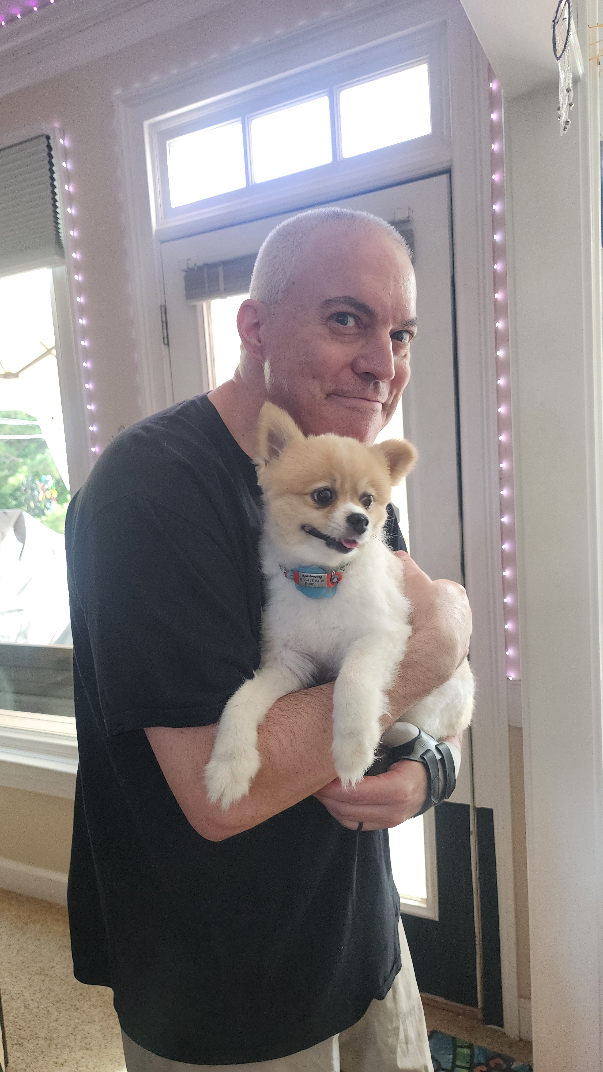
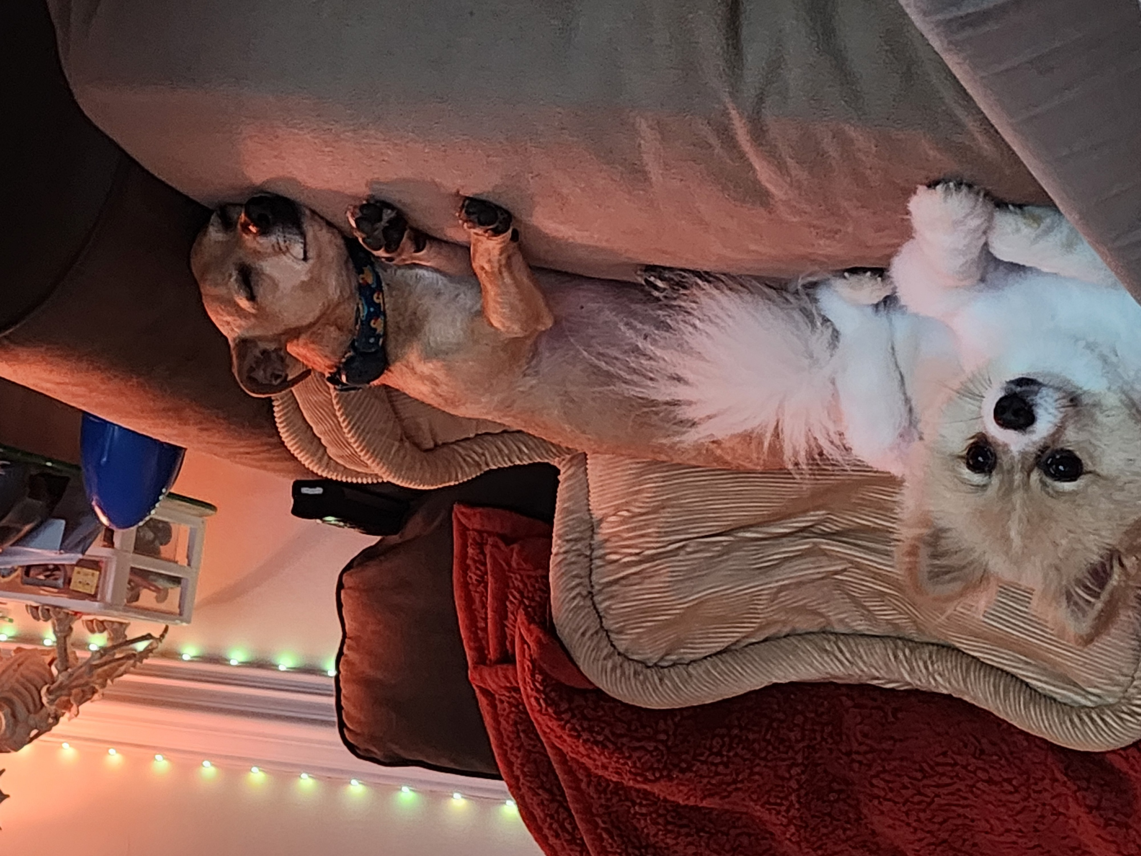
Ground Rules
This session is for you, so please participate.
These are tricks and tips that worked for me but might not be right for everyone or every situation. Please consult a coach or physician to find a program that is best for you.
No animals were harmed during the creation of this presentation, and please support pet rescue groups.
This presentation is sponsored by Dumpling and Noodle

Slide 5


Think About How You Feel Most Workdays
Photo by Jack Sparrow from Pexels
Photo by Oladimeji Ajegbile from Pexels

Slide 6
Do not edit
How to change the design
How do you feel most days at work?
The Slido app must be installed on every computer you’re presenting from

Slide 7

Stress Test - How Fast Is the Image Spinning?
It’s just art, not a real stress test!
Image by Yurii Perepadia

Slide 8
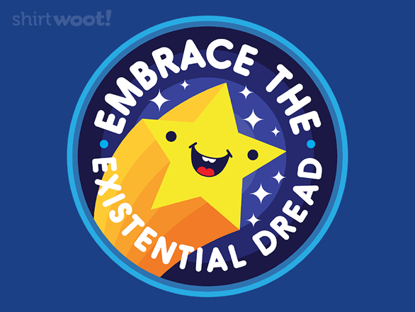
The most important factor is how you face reality and keep moving.
https://shirt.woot.com/offers/embrace

Slide 9
Activity 1: Workday Energy Audit (15 min)
Solo (5 min): Sketch a typical week and mark the two moments you feel most drained and two moments most energized
Group discussion (10 min): What patterns repeated?
Playbook Capture - Block 1: My Drains and Energizers
22 September 2026
Notes:
Setup (30 sec): hand out canvas page 1. Tell them nothing is collected - this is theirs.
Solo 4 min: 'Sketch a normal sprint week across the top of a sticky. Mark an X where you feel most drained, a star where you feel most energized.' Give a 1-minute warning.
Slido word cloud 2 min: launch the poll, read the cloud aloud, name the two or three largest words.
Table debrief 4 min: prompt - 'What shows up for everyone, and what is specific to your role?'
Transition: 'Those drains are your stress inputs. Next we look at what they do to your body.'

Slide 10


Leading Through Uncertainty
?
Photo by Diva Plavalaguna
Photo by SHVETS production
Notes:
Who do you want to be?

Slide 11

Emotional Fitness
Being emotionally and mentally ready for anything (well, most things)
Photo by cottonbro from Pexels

Slide 12
Chance favors only the prepared mind.
- Louis Pasteur
Paraphrased from Lecture, University of Lille (7 December 1854)

Slide 13
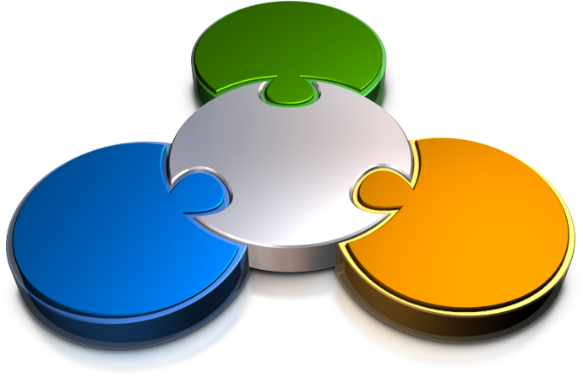
Why Emotional Fitness Matters
Prepares us to survive crises and everyday challenges
Gives us a competitive advantage
Reduces the risk and impact of PTSD and chronic stress

Slide 14
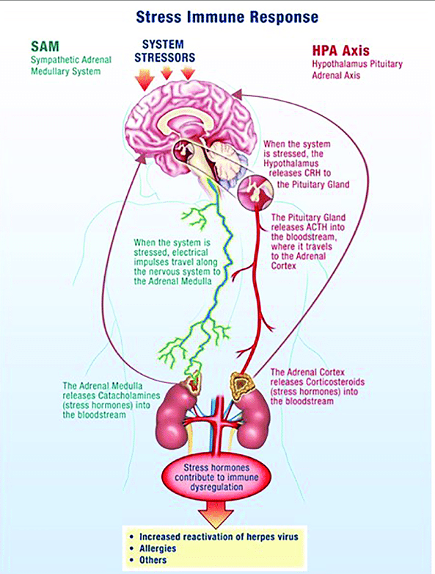
Stress Response
Short-term stress:
“Fight or Flight” - Sympathomedullary Pathway (SAM)
Long-term stress:
Hypothalamic-Pituitary-Adrenal (HPA) system
Herpes Virus Reactivation in Astronauts During Spaceflight and Its Application on Earth

Slide 15
Sympathomedullary Pathway (SAM)
Increased heart rate
Increased breathing rate and bronchial dilation
Decreased digestive activity
Released glucose from liver for energy
What is the Stress Response?

Slide 16
Do not edit
How to change the design
How many times per week does your "Fight or Flight " SAM kick in?
The Slido app must be installed on every computer you’re presenting from

Slide 17
Hypothalamic Pituitary-Adrenal (HPA)
ACTH stimulates adrenal glands to produce corticosteroid (hormone)
Blood sugar levels help a person until the body to returns to normal
Hypothalamus stimulates pituitary gland
2
4
5
1
3
5
HPA activated
Pituitary gland secretes adrenocorticotropic hormone (ACTH)
Cortisol provides steady supply of blood sugar
What is the Stress Response?

Slide 18
Consequences of Long-term Stress
Mental health: depression, anxiety, and personality disorders
Cardiovascular: heart disease, high blood pressure, heart attacks, stroke
Obesity and eating disorders
Menstrual problems
Sexual dysfunction
Skin and hair problems: acne, psoriasis, eczema, and permanent hair loss
Gastrointestinal: GERD, gastritis, ulcerative colitis, and irritable colon
Muscles in the body stay in a tense state of guardedness
Increased immune system activation: chronic fatigue, metabolic disorders, depression, and immune disorders
Changes in gut bacteria which influence mood
Weakening of the intestinal barrier allowing bacteria to enter the body
Repeated triggering of physical reactions wears out the body
Increased inflammation
What are the consequences of long-term stress?; Stress Symptoms
Stress effects on the body

Slide 19
Do not edit
How to change the design
Are you experiencing long-term stress (HPA)?
The Slido app must be installed on every computer you’re presenting from

Slide 20
Activity 2: Map Your Stress Signature (15 min)
Solo (5 min): List your earliest physical, emotional, and behavioral stress signals. These are the ones that show up before you notice you are stressed.
Whole room (10 min): Volunteers share one early-warning signal.
Playbook Capture - Block 2: My Early Warning Signals and Triggers
Notes:
Setup: reference the SAM and HPA slides - these signals are the physical system firing early.
Solo 5 min: three columns - physical, emotional, behavioral. Push for the EARLY signs, not the meltdown.
Pairs 5 min: swap lists. Each names one concrete work trigger. Keep it to work, not home.
Whole room 2 min: take three volunteers only. Do not let this run long.
Facilitator note: if the room goes quiet, share one of your own signals first to lower the risk.

Slide 21

Mindfulness
Focused awareness and acceptance
Thoughts
Feelings
Mood
Body
Photo by cottonbro from Pexels

Slide 22
Mindfulness
Situational awareness
Introspection
Acceptance
Mindfulness

Slide 23
Activity 3: Applying Mindfulness to common triggers (15 min)
Guided practice - Common triggers (5 min): For each trigger mentioned, record your Thoughts, Feelings, Mood, and Body reaction
  Thoughts
  Feelings
  Mood
  Body
Guided practice - Acceptance (10 min): Review each reaction. Imagine the trigger is OK and you’ll be fine. Try to accept the trigger as true but harmless.
Playbook capture - Block 3: My 3-Minute Reset: For each awareness area, how can I accept and neutralize my reaction?
Notes:
Setup: lower the lights if you can. Eyes closed optional - no pressure, no judgment.
Guided 3 min: slow pace. Thoughts, then feelings, then mood, then body. Long pauses between each.
Solo 2 min: 'Write what you noticed, not what you think you should have noticed.'
Slido rating 2 min: normalize low scores - a wandering mind is the practice, not a failure.
Transition: 'Mindfulness lets you notice the feeling. Next: what to do once you have noticed it.'

Slide 24
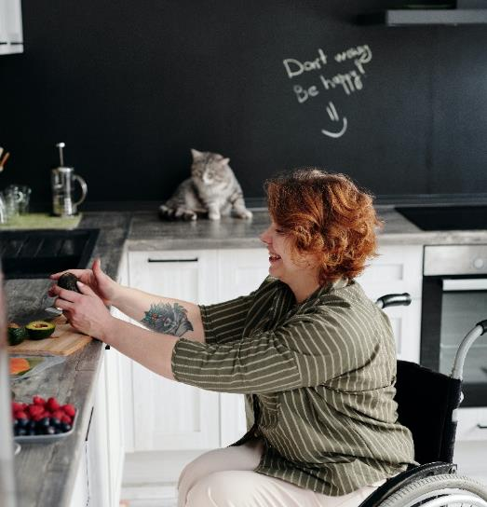
Emotional Validation
Tolerating and accepting emotional discomfort
“Negative feelings, no matter how intense, can’t actually hurt us.”
- Nick Wignall, NickWignall.com
Emotional Fitness: 3 Essential Habits for Better Mental Health

Slide 25
Activity 4: Name It to Tame It (15 min)
Solo (5 min): Write one recent work moment where you pushed a feeling aside.
Tables (5 min): Practice validating language. No advice and no fixing allowed.
  Name the trigger.
  Explain why it’s OK to react that way and that your reaction is valid.
  Take a deep breath and say “I’m perfectly justified to feel BLANK in these situations.
Discussion (5 min): What changed when the feeling was named instead of argued with?
Playbook capture - Block 4: My Validation Phrases
Notes:
Setup: restate Wignall - negative feelings, however intense, cannot actually hurt us.
Solo 3 min: one recent work moment only. Keep it small and real.
Pairs 5 min: model the phrasing first - 'That makes sense because...' Then enforce the rule: no advice, no fixing, no silver linings.
Debrief 2 min: ask what it felt like to be heard without being solved. This usually lands hard with PMs and leads.
Watch for: pairs sliding into problem-solving. Interrupt gently and redirect.

Slide 26
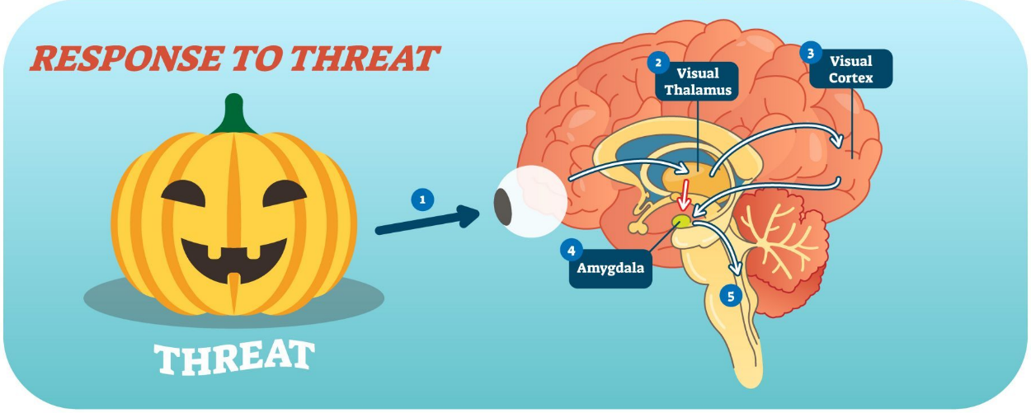
Processing stimuli - meet your amygdala
Amygdala
The amygdala is a primary part of our emotional response to stimuli, decision-making, and formation of memories.
"Amygdala: The powerhouse of emotions", Jessica Taylor, February 9, 2018
Notes:
The amygdala helps us process current and past events.
Think about your reaction to a scary movie (Jaws - I still don’t like to get into a swimming pool).
What about a happy moment like when your child was born?
This processing is very important to our survival and emotional fitness but can work against us with the “threats” we experience today.
PMP/CBAP examples.
"Amygdala: The powerhouse of emotions", Jessica Taylor, February 9, 2018

Slide 27

Trigger a happier amygdala
“‘It gives people a place to park their mental worries,’ says Sue Varma, M.D., a board certified psychiatrist in New York City. ‘The rhythmic sensation of any motion is a form of self soothing – like tapping your feet or shaking your leg.’”
Fidgeting creates kinesthetic stimuli that help us focus and pay attention for longer periods of time.
– Forbes Health, 2022
Photo by Phils Wei from Pexels
Notes:
Fidgeting is one way to relax the amygdala. It provides a calming, repetitive input that helps tell our minds that we are relaxed and happier.

Slide 28
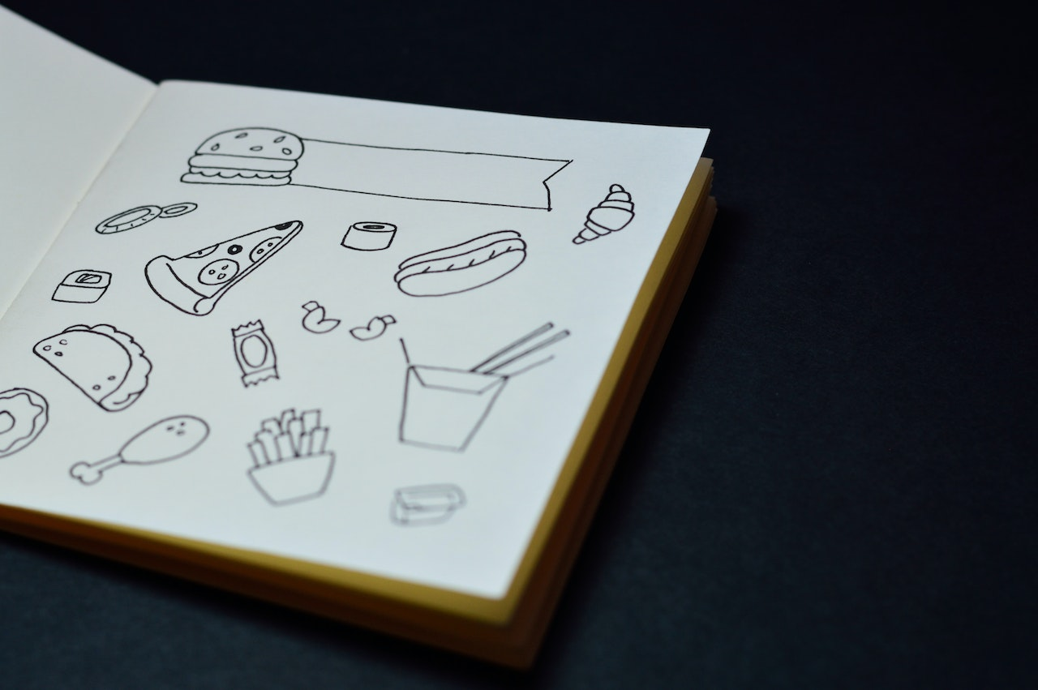
Toys improve performance
Stimulates the brain with movement
Relieves anxiety
Improves focus for ADHD
Reduces PTSD impact
29% increase in memory recall from just doodling
Journal of At-Risk Issues, 2006
Applied Cognitive Psychology, 2010
Notes:
Photo by Miguel Á. Padriñán from Pexels: https://www.pexels.com/photo/opened-coloring-book-932262/

Slide 29


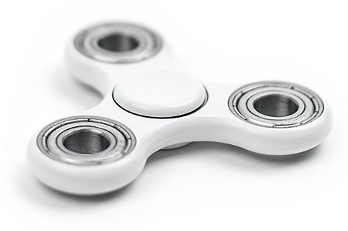
1
Determine which fidgeting motions soothe you.
2
Find toys that provide the right stimulus.
3
Vary your toys and fidgeting to keep the input fresh and relaxing.
Info-Tech Research Group
Notes:
Photo by Zoltán Pethő from Pexels: https://www.pexels.com/photo/close-up-photo-of-a-fidget-toy-10412871/
Photo by Sebastian Voortman from Pexels: https://www.pexels.com/photo/white-3-blade-fidget-spinner-422290/

Slide 30
Activity 5: Fidget Lab (10 min)
Round-robin (5 min): Try different fidget types to see what you like.
Discussion (5 min):
  Which motions settle you?
  Which ones are a distraction?
  How often do you change or rotate?
Playbook capture - Block 5: My Focus Tools, plus a rotation plan to keep the input fresh.
Notes:
Setup: have the toy tray ready - squeeze, spin, click, and textured items. One tray per table.
Round-robin 5 min: 30 seconds per item, then pass. Keep the tray moving.
Solo 3 min: rate settles me / distracts me. Tie back to the 29 percent doodling recall stat.
Slido multiple choice 2 min: show the split - it proves there is no single right tool.
Close: remind them to vary the toys so the input stays fresh.

Slide 31
Do not edit
How to change the design
Which fidget types work the best for you?
The Slido app must be installed on every computer you’re presenting from

Slide 32






Perception: Who has an ideal, healthy body?
1
2
3
Photos from Pexels
Notes:
I’m a model - The before picture in most ads.

Slide 33
Do not edit
How to change the design
Who has the ideal, healthy body?
The Slido app must be installed on every computer you’re presenting from

Slide 34



Battle bias with Cognitive Restructuring
Interrupting and redirecting destructive and self-defeating thought patterns that create a distorted or unhealthy view of reality
They are all the same model.
Photos by Jake Ryan from Pexels

Slide 35
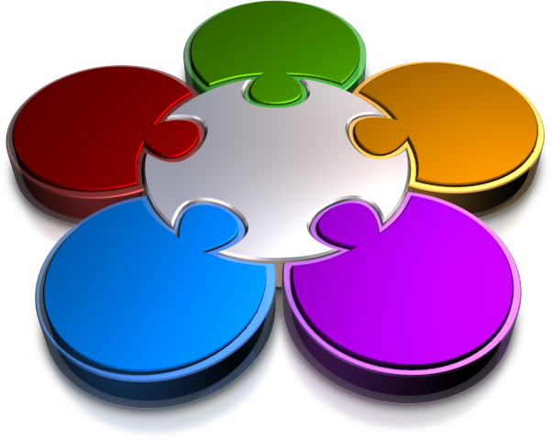
Cognitive Restructuring - Techniques
  Self-monitoring
  Generating alternatives
  Questioning your assumptions
  Performing a
  cost-benefit analysis
  Gathering evidence
How to Change Negative Thinking with Cognitive Restructuring

Slide 36
Activity 6: Cognitive Restructuring Role-Playing (15 min)
Solo (5 min): Write one recurring self-defeating thought from work, such as “I will be blamed for the delay”.
Role-Playing (10 min): Run the five techniques on each thought:
  Self-monitor
  Question Assumptions
  Gather Evidence
  Weigh Costs and Benefits
  Generate Alternatives
Playbook capture - Block 6: My Reframes
(top distortion and the replacement thought).
Notes:
Setup: this is the longest activity. Protect the time and cut the debrief instead if you run over.
Solo 4 min: one recurring thought, written in the exact words they hear in their head.
Role-Playing 9 min: 3 minutes per thinker, call the rotation yourself. Listeners ask questions only.
Run the five techniques in order: self-monitor, question assumptions, gather evidence, generate alternatives, cost-benefit.
Debrief: ask one triad what evidence actually disproved a thought. Land the point that the thought was never the fact.

Slide 37

Leading Through Uncertainty
?
Photo by Diva Plavalaguna
Photo by SHVETS production
Notes:
Who do you want to be?

Slide 38



Volume Isn’t Reality
Photos by Pixabay from Pexels

Slide 39


Escape the Echo Chamber
Confirmation Bias
Unplug from News and Social Media
Photo by Pixabay from Pexels
Photo by Pressmaster from Pexels
Notes:
Story of my mom

Slide 40
Serenity Poem Applied
Grant me the serenity to Accept
the things I cannot Change,
Courage to Change the things I can,
and Wisdom to know the Difference.

Slide 41

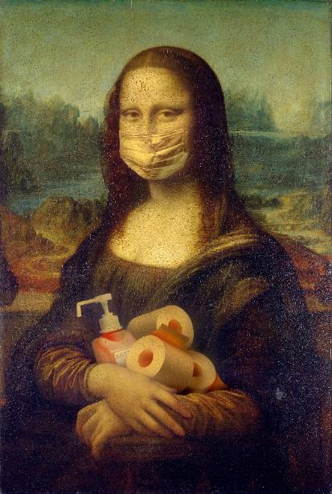
Be Prepared to Reduce Stress and Fear
Photo by Anna Shvets from Pexels
Photo by Yaroslav Danylchenko from Pexels

Slide 42
Two Techniques For Better Preparation
Rehearsal and Role-Playing
Outcome Based Visualization
Talk through the challenge or confrontation you are dreading.
Play the conversation from the perspective of different participants.
Repeat the conversation until you feel comfortable with each angle.
Visualize what success would look like.
How would you know if things had changed?
What would need to happen to get there?
Outcome Based Treatment; The Science Behind Outcome-based Mental Health Care; Switch: How to Change Things When Change Is Hard

Slide 43
Activity 7: Rehearse the Conversation You Are Dreading (15 min)
Solo (5 min):
  Choose a real upcoming conversation. E.G., a slipped date, a scope pushback, a performance discussion.
  Outcome-based visualization: What will success look like? How will you know you got there?
  Mentally role-play the conversation, taking a deep breath between iterations.
Role-playing (10 min):
  Share your scenario and planned audience.
  Role-play with another person or with your table.
  Rotate to the next person.
Playbook capture - Block 8: My Rehearsal Script and Success Visualization
Notes:
Setup: this is the highest-value activity for leads. Make sure the conversation they pick is real and upcoming.
Solo 3 min: choose and write the opening line they are dreading.
Role-Playing 9 min: 3 minutes each. Roles - self, other party, observer. Observer notes what shifted.
Call the rotations out loud. Encourage a replay of the same conversation rather than moving on too quickly.
Solo 3 min visualization: what does success look like, and how would you know it happened? Push for an observable signal.

Slide 44

Use Breathing to Center Yourself
Slowly inhale a deep breath for 4 seconds.
Hold the breath in for 4 seconds.
Slowly exhale the breath out for 4 seconds.
Hold the empty breath for 4 seconds.
Repeat until your breathing is under control.
Photo by Cliff Booth from Pexels

Slide 45
If you are mentally and emotionally prepared,
you will outperform others and be better positioned to lead and succeed.
- Hans Eckman
Eckman Guides

Slide 46
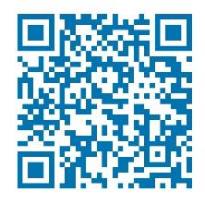
Stay Connected - Phone a Friend!
Hans@HansEckman.com
EckmanGuides.com
  Free access to all presentations, interviews, podcasts, and articles
Connect on LinkedIn
Eckman Guides on YouTube
Eckman Guides on Facebook
Hans Eckman on Twitter
Scan for LinkedIn

Slide 47
Emotional Fitness Playbook
1. Workday Energy Audit
Two moments that drain me / two that energize me:
2. My Stress Signature
Body, mood, and behavior signs + the triggers that set them off:
3. Applying Mindfulness to Common Triggers
For each awareness area, how can I accept and neutralize my reaction:
Thoughts:
Feelings:
Mood:
Body:
4. Name It to Tame It
What I say to myself and others instead of pushing a feeling away:

Slide 48
Emotional Fitness Playbook
5. My Focus Tools
Fidget or movement input that settles me + rotation plan:
6. Cognitive Restructuring
Distorted thought -> evidence -> replacement thought:
7. My Rehearsal Script
My Rehearsal Script and Success Visualization:

Slide 49
References and Additional Resources (In no order)
https://nickwignall.com/emotional-fitness-introduction
https://www.entrepreneur.com/article/254711
https://hesonline.com/2019/10/07/elements-emotional-fitness/
https://nickwignall.com/emotional-fitness-introduction/
https://nickwignall.com/emotional-fitness/
https://www.psychologytoday.com/us/blog/emotional-fitness
https://www.familyeducation.com/life/general-health/emotional-fitness
https://havingtime.com/3-powerful-tips-to-improve-your-emotional-fitness/
https://www.psychologytoday.com/us/blog/emotional-fitness/202008/10-useful-tips-emotional-problem-solving
Train Your Attention Muscle with Mindfulness https://nickwignall.com/emotional-fitness/#mindfulness
10 Types of Negative Self-Talk (and How to Correct Them) https://nickwignall.com/negative-self-talk/
McKay, Brett (16 August 2013). "Arousal and Performance: How Stress and Fear Affect Tactical Performance". The Art of Manliness. Retrieved 7 June 2019..
Ayoob, Massad (2011). Combat Shooting with Massad Ayoob. Gun Digest Books. p. 11. ISBN 9781440218590.
Rosenberg, Joel (2011). The Carry Book: Minnesota Edition. Elegon. p. 52. ISBN 9781257015948.
https://armeddefense.org/color-code THE COLOR CODE OF AWARENESS BY ADTA MEMBER WU CHIN
https://kravmagamindset.wordpress.com/2018/05/30/coopers-color-code-and-the-combat-mindset/ Cooper’s Color Code and the Combat Mindset

Slide 50
References and Additional Resources (In no order)
Building Awareness With the “Cooper Code” http://ww2.safepilots.org/building-awareness-with-the-cooper-code/
Managing Stress Arousal for Optimal Performance: A Guide to the Warrior Color Code https://www.artofmanliness.com/articles/managing-stress-arousal-for-optimal-performance-a-guide-to-the-warrior-color-code/
On Combat, The Psychology and Physiology of Deadly Conflict in War and in Peace 3rd Editionby Dave Grossman (Author), Loren W. Christensen (Author)
http://ww2.safepilots.org/building-awareness-with-the-cooper-code/
https://en.wikipedia.org/wiki/Serenity_Prayer American theologian Reinhold Niebuhr (1892–1971)
What are the consequences of long-term stress? https://www.webmd.com/balance/stress-management/qa/what-are-the-consequences-of-longterm-stress
Chronic stress puts your health at risk https://www.mayoclinic.org/healthy-lifestyle/stress-management/in-depth/stress/art-20046037
5 Things You Should Know About Stress https://www.nimh.nih.gov/health/publications/stress/index.shtml
McLeod, S. A. (2010). What is the stress response. Simply Psychology. https://www.simplypsychology.org/stress-biology.html
Brianna Chu; Komal Marwaha; Terrence Sanvictores; Derek Ayers. Physiology, Stress Reaction, October 10, 2020, https://www.ncbi.nlm.nih.gov/books/NBK541120/
The long-term costs of traumatic stress: intertwined physical and psychological consequences ALEXANDER C. McFARLANE1 https://www.ncbi.nlm.nih.gov/pmc/articles/PMC2816923/

Slide 51
References and Additional Resources (In no order)
What are the four phases of PTSD? Here’s a comprehensive look at the impact phase, the rescue phase, the intermediate recovery phase, and the long-term reconstruction phase Taylor Bennett by Taylor Bennett, Jun 21, 2018, Counseling News, Mental Health, PTSD; https://thriveworks.com/blog/four-phases-ptsd-impact-rescue-intermediate-recovery-long-term-reconstruction
Stress Symptoms https://www.webmd.com/balance/stress-management/stress-symptoms-effects_of-stress-on-the-body
Stress effects on the body https://www.apa.org/topics/stress-body
https://medium.com/eleos-health/the-science-behind-outcome-based-mental-health-care-51ca5c9967e6
https://www.psypost.org/2020/03/negative-news-evokes-stronger-psychophysiological-reactions-than-positive-news-56180
https://www.simplypsychology.org/stress-biology.html
Outcome Based Treatment
The Science Behind Outcome-based Mental Health Care
Switch: How to Change Things When Change Is Hard by Chip Heath, Dan Heath
The Five Dysfunctions of a Team: A Leadership Fable by Patrick Lencioni
Drive: The Surprising Truth About What Motivates Us by Daniel H. Pink
Crucial Conversations Tools for Talking When Stakes Are High, Second Edition by Kerry Patterson, Joseph Grenny
Linchpin: Are You Indispensable? by Seth Godin
Inside the Magic Kingdom : Seven Keys to Disney's Success by Tom Connellan

Slide 52
References - Sensory Toys
Learn More about your brain and fidgeting
“Amygdala.” Wikipedia, 2022.
Andrade, Jackie. “What does doodling do?” Applied Cognitive Psychology, vol. 24, no. 1, Jan. 2010, pp. 100-106.
Bernhard, Blythe. “Brief diversions may help employees improve work, study says.” Phys.org, 17 Feb. 2011.
Farley, James, et al. “Everyday attention and lecture retention: the effects of time, fidgeting, and mind wandering.” Frontiers in Psychology, vol. 4, article 619, Sept. 2013.
Ismail, Nabila, and Jessica Lester. “Your Guide To Anxiety Fidget Toys.” Forbes Health, 27 June 2022
Isbister, Katherine. “Fidget Toys Aren't Just Hype.” The Conversation US, in Scientific American, 18 May 2017.
Stalvey, Sheryl, and Heather Brasell. “Using Stress Balls to Focus the Attention of Sixth-Grade Learners.” Journal of At-Risk Issues, vol. 12, no. 2, 2006, pp. 7-16.
“The Science Behind Fidget Toys.” Sensory Edge, n.d.
"The Surprising Science of Fidgeting,” The Conversation, in Neuroscience News, 24 May 2017.
Taylor, Jessica. “Amygdala: The powerhouse of emotions.” CogniFit, 8 Feb. 2018.
Todd, Lindsey. “Can fidget toys be useful for people with anxiety?” Medical News Today, 29 June 2021.

Slide 53
Stay Connected - Phone a Friend!
Hans@HansEckman.com
EckmanGuides.com
  Free access to all presentation, interviews, podcasts, and articles
Connect on LinkedIn
Eckman Guides on YouTube
Eckman Guides on Facebook
Hans Eckman on Twitter
Scan for LinkedIn

