Slide 1
Achieving more by Doing Less
I’m lazy and productive,
and you can be too!

Slide 2
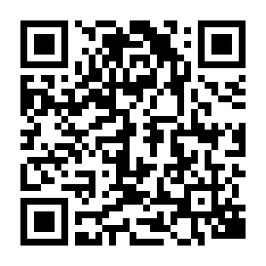
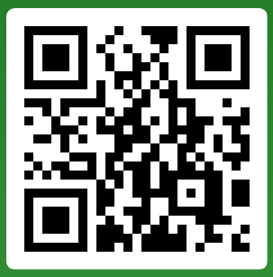
Achieving More by Doing Less Workshop
EckmanGuides.com
Download the workshop materials:
Play along: SLIDO.COM
Event code: 224 733
Scan the QR code.

Slide 3
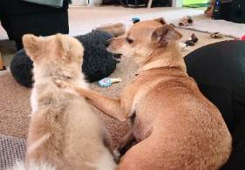
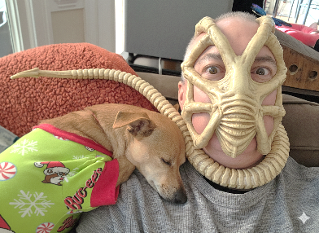
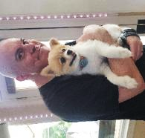
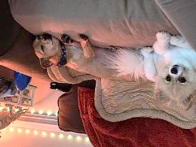
Ground Rules
This session is for you, so please participate.
These are tricks and tips that worked for me but might not be right for everyone or every situation. Please consult a coach or physician to find a program that is best for you.
No animals were harmed during the creation of this presentation, and please support pet rescue groups.
This presentation is sponsored by Noodle and Dumpling.

Slide 4
Do not edit
How to change the design
How many hours per week are you working?
The Slido app must be installed on every computer you’re presenting from

Slide 5
So Where Did All Our Time Go? (Full-time 2024-2025)
Only 40.32 hours?
American Time Use Survey 2025 Results (BLS)
American Time Use Survey 2024 Results (BLS)
Time use and teleworkers (Statistics Canada 2024)
Time Use Survey Brochure (Statistics Canada 2025)

Slide 6
How do we ever get work done?!
117 Emails per day | ~2 minutes between disruptions
153 Teams messages per day | 50% of meetings are between 9:00 – 3:00
50+ messages after work hours, | 57% of meetings are ad hoc calls
29% checking email until 10 pm | 10% of meetings are booked last minute
20% checking email on weekends | 33% of meetings span time zones
Breaking down the infinite workday, Microsoft, 17 JUN 2025

Slide 7



Things We Shouldn’t Cut
Bathing, sleeping, learning, relaxing, dreaming, bathing, and bathing
Photos by cottonbro, Marcus Aurelius, and Pixabay from Pexels

Slide 8



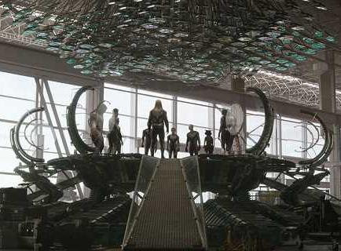

We Can’t Add Time, but We Can Use It More Effectively
What do we want?
TIME TRAVEL
When do we want it?
IT’S IRRELEVANT!!!
Hot Tub Time Machine, Avengers: Endgame, Back to the Future, The Time Machine, Doctor Who, Time Travel

Slide 9

Use Moderation to Maintain Sanity
You aren’t helping anyone if you burn out and start making careless mistakes.
Photo by Nandhu Kumar from Pexels

Slide 10

Phone a Friend
Your friends and network are here to help whenever you need it.
Tips and templates
Sounding board for ideas
Coaching
Someone to vent to
(Watch: Critical importance of a work spouse)
Photo by cottonbro from Pexels

Slide 11


Take Back Control of Your Social Media
Time box social media activities
Pick a theme for each time box
Don’t feed the trolls
Photo by Ellie Burgin from Pexels
Photo by Alex Green from Pexels

Slide 12

Brain Teaser
Goal:
Fill your Sprint Cup from the Backlog Pitcher
Rules:
You start with a full 1 L pitcher (demand).
Your cup holds 400 ML and can be emptied once per week (capacity).
Every week, 420 ML is added to the pitcher.
You cannot add glasses, pitchers, or drink the water.
How do you empty the pitcher using only the glass?
Note: Lemons are purely for decoration and not a factor in the solution.
Photo by Julia Zolotova from Pexels

Slide 13

Brain Teaser
You
Can’t
Complete
Everything!
Photo by Julia Zolotova from Pexels

Slide 14

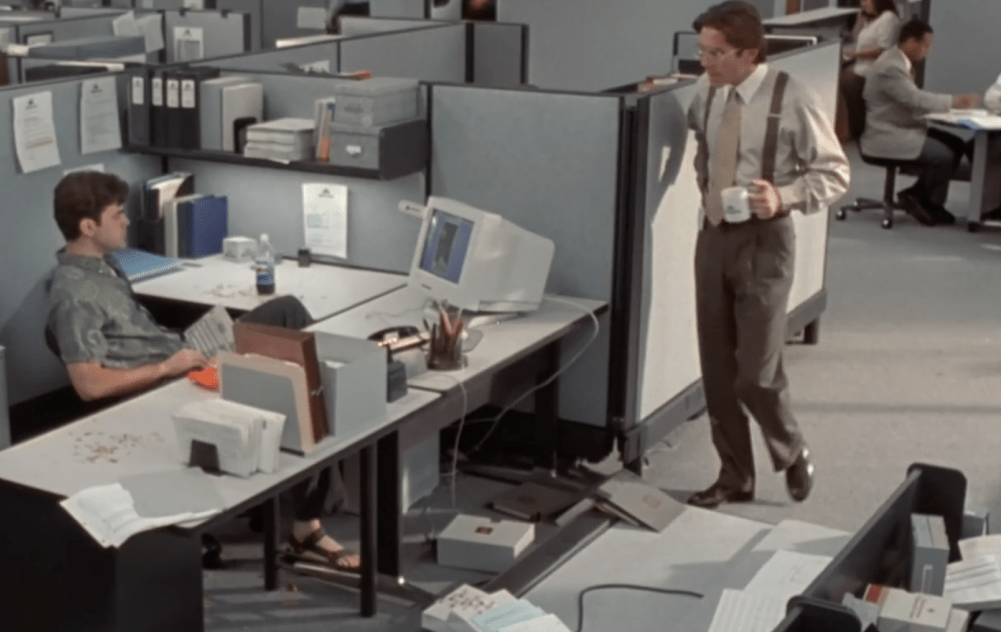
90-Day’s Effort in 60-Days
Shakubuku:
A swift spiritual kick to the head that resets your perspective and thinking.
Image: Office Space; Quote: Grosse Point Blank;
Photo by Mikael Blomkvist from Pexels
Notes:
Home healthcare app. Client estimated 3 month’s work, only wanted to pay 2 months to get POC defined. Give them the best you can do for 60 days, be honest, and clearly define scope of work.

Slide 15
Administrative Work vs Primary Work Activities
ADMINISTRATIVE WORK
PRIMARY WORK
Shared upkeep everyone handles, regardless of their delivery role.
  Checking email and responding to messages
  Attending company meetings
  Timesheets
Recurring services you provide that help the team deliver solutions.
  Discussing an issue or decision related to the project
  Facilitating a requirements meeting
  Backlog refinement
  Triaging defects

Slide 16
Define Your Services and Primary Work Activities
Services​/Primary Work Activities | Importance / Urgency​ | Influence / Authority​ | Superpowers (strengths)​
Requirements Elicitation & Backlog Refinement
Process Mapping & Workflow Optimization
Project Schedule, Milestones & Sprint Delivery
Risk, Assumptions, Issues & Dependencies (RAID) Management
Stakeholder Engagement & Communication Cadence
User Acceptance Testing (UAT) & Solution Validation
Triage, Production Support
Change Management, Training & Handover Documentation

Slide 17

Reduce Waste
The 8 Wastes of Lean (adapted)
T - Transportation:
Unnecessary movement
I - Inventory:
Excess work-in-progress (WIP)
M - Motion:
Unnecessary movement
W - Waiting: Idle time
O - Overproduction:
Doing more than is needed
O - Overprocessing:
More effort or quality than required
D - Defects:
Errors or rework.
S - Skills (Unused Talent):
Underutilized skills and creativity
Photo by Miguel Á. Padriñán from Pexels
The 8 Wastes of Lean, Nawras Skhmot, 5 AUG 2017

Slide 18
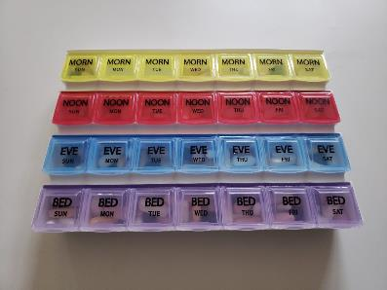
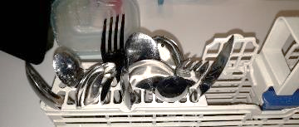
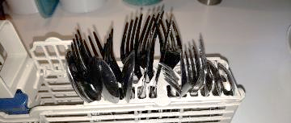
Simplify and Automate Repetitive Tasks
Sort first
Daily: 4 min x 30 days = 120 min/month
Monthly: 15 min sorting + (10 sec x 30 days) = 100 min/month saved!
AJ
Pills

Slide 19
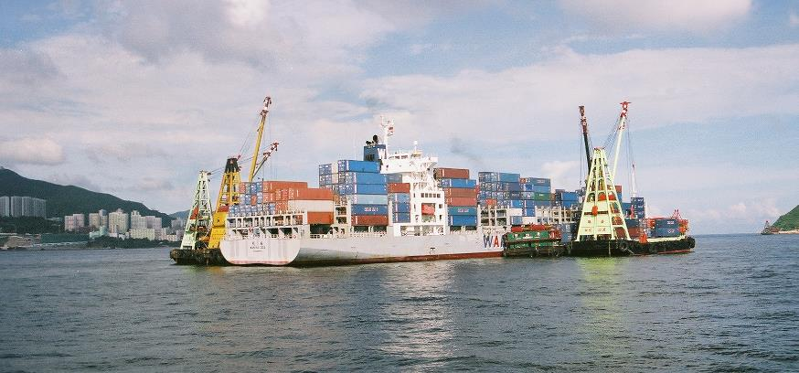
Joe Knows Freight Forwarding
Photo by Hans Eckman, Hong Kong

Slide 20
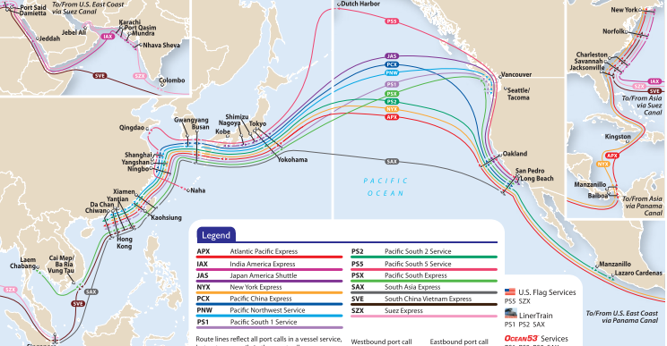
Joe Knows Freight Forwarding - Be Proactive!
NO Updates!
YES!
YES!
Tracking # | Last Update | Action
1396813413 | In Transit | Monitor for Exceptions
36713411 | Arrival Date Confirmed | Pick-up Scheduled
837831873 | At Port | Pick-up Today
Image: https://www.shiplilly.com/blog/asia-north-america-ocean-shipping-routes/

Slide 21
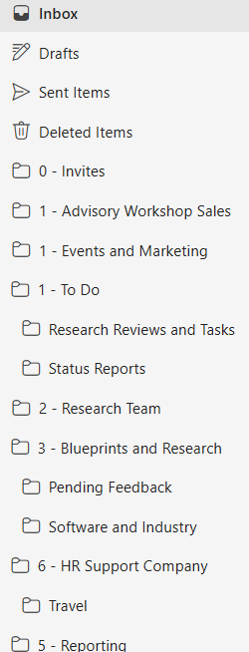
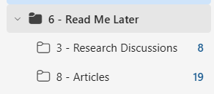
Stop Answering Emails!
17!
Keep manageable
(O.H.I.O.)
Decide what’s most important.
Only Handle It Once.
Filter everything else and ignore.
If it’s important, they will contact you directly.
The lie we tell ourselves
This is never going to happen
6,983
1,543

Slide 22



Boost Productivity with AI
Email replies
Meeting follow-up
First drafts
Have AI suggest a response based on long or complicated threads
Turn meeting notes into a draft action list.
Turn rough notes into a clear stakeholder update.
“Draft a response thanking them and suggesting their concerns should go to the steering committee.”
“List the decisions, owners, and due dates in these notes. Add tasks to Outlook.”
“Draft a short status update from these notes. Flag gaps and stakeholder actions needed.”
Review every output. Use approved work data. Features vary by license and settings.
Notes:
Example prompts for Microsoft 365 Copilot, tailored to everyday personal productivity. These are illustrative prompts, not captured product output or measured time savings. The meeting example uses notes supplied by the user and does not assume automatic access to every meeting. Provide the email thread or relevant notes in an approved work context when needed. Verify summaries against the source, confirm action owners and dates, and edit drafts before sharing. Access and integrations depend on licensing, organizational settings and permissions.
Visuals: three AI-generated conceptual icons for email, meeting discussion and document drafting. These are not Microsoft application icons or product screenshots.
Source limitation: web search returned no usable results and direct access to Microsoft documentation was unavailable in this session. Examples are framed as suggested workflows rather than verified current feature availability or guaranteed productivity gains.

Slide 23

Switching Costs
It takes 25+ minutes to recover productivity from an interruption.
- The Cost of Interrupted Work: More Speed and Stress
Significant multitasking reduces your effective IQ 3x more than marijuana. - 'Info-mania' dents IQ more than marijuana
2% of the population can effectively multitask. - 2012, David Strayer
Learn more: The High Cost of Multitasking
Photo by Peggy Anke from Pexels

Slide 24
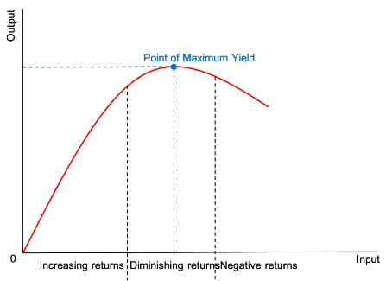

Don’t Let PERFECT Ruin GOOD ENOUGH
Law of Diminishing Returns:
Adding another factor of production yields smaller increases in output.
Only valid when you have extra time or when it really matters.
How much of your time is being spent in here?
Graph: Wikipedia; Photo by Andrea Piacquadio from Pexels
Notes:
Time spent getting all the fonts consistent and aligned.

Slide 25

Focus on High ROI Activities
Every gambler knows
That the secret to survivin'
Is knowin' what to throw away
And knowin' what to keep
'Cause every hand's a winner
And every hand's a loser
Kenny Rogers - The Gambler
Photo by Anastasiya Badun from Pexels

Slide 26
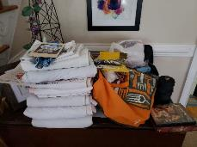
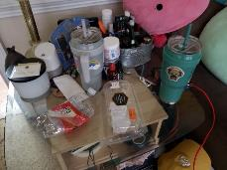
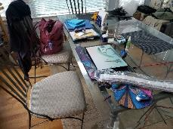
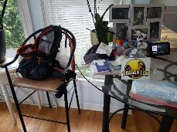
Home Rule: NO CLUTTER ALLOWED!
In what order should these areas be cleared?
1
2
Play along: SLIDO.COM
Event code: 224 733
Table in the family room
End table next to couch
3
4
Sunroom table
Sunroom high-top table

Slide 27
Do not edit
How to change the design
In what order should these areas be cleared?
The Slido app must be installed on every computer you’re presenting from

Slide 28
Home Rule: NO CLUTTER ALLOWED!
The correct order for putting things away:
4
1
Understand what clutter is:
Anything out of place…
That isn’t my wife’s!
Kitchen high-top table
Table in the family room
2
3
This is not clutter:
End table next to couch
Kitchen table

Slide 29
Setting Priorities: Modified Eisenhower Matrix
High
2. FOCUS TIME Most Productive Use Of Time AI-Assisted/Paired Development (High ROI) | 1. Emergency Fix It Now! Plan Better. AI-Assisted (Unnecessary Expense)
3. Stretch Goals Good Enough Delivery. Time/Scope Box Automate and AI-Outsource Core Tasks (Low ROI)
Nope FUN, But Just Say NO! Not Productive (Negative ROI) | 4. AUTOMATE, DELEGATE, Or DECLINE Time Wasters (Negative ROI)
IMPORTANCE
Low
High
URGENCY

Slide 30
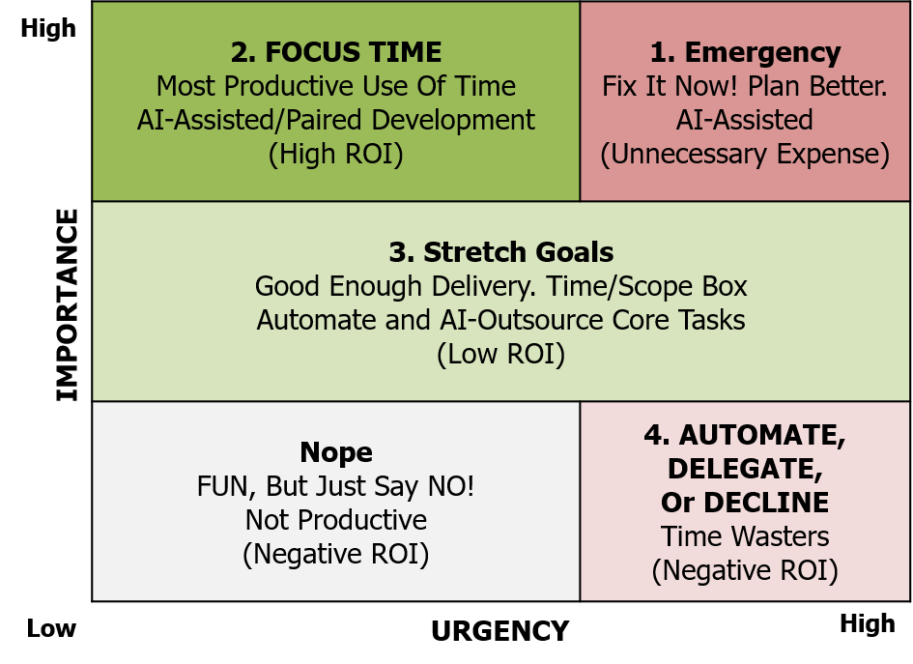
Define Your Services and Primary Work Activities
Services​/Primary Work Activities | Importance / Urgency​ | Influence / Authority​ | Superpowers (strengths)​
Requirements Elicitation & Backlog Refinement | 2. Focus Time (High/Low)
Process Mapping & Workflow Optimization | 3. Stretch Goals (Medium/All)
Project Schedule, Milestones & Sprint Delivery | 2. Focus Time (High/Low)
Risk, Assumptions, Issues & Dependencies (RAID) Management | 2. Focus Time (High/Low)
Stakeholder Engagement & Communication Cadence | 2. Focus Time (High/Low)
User Acceptance Testing (UAT) & Solution Validation | 4. Automate, Delegate, Decline (Low/High)
Triage, Production Support | 1. Emergency (High/High)
Change Management, Training & Handover Documentation | 3. Stretch Goals (Medium/All)

Slide 31

Only Work on Things You Can Influence
Grant me the serenity to accept the things I cannot change (yet),
Courage to change the things I can,
and Wisdom to know the difference.
Think Globally,
Act Locally
Adapted from Serenity Prayer by Reinhold Niebuhr

Slide 32
Influence vs Authority
INFLUENCE
AUTHORITY
Ability to shape decisions through trust and persuasion.
Formal right to make decisions within your assigned role.
You build support, even when someone else owns the decision.
You set direction and remain accountable for the decision.
Win stakeholder support for a change to project priorities.
Prioritizing items in your product roadmap and backlog.
You can influence beyond your authority. Strong leaders use both.
Notes:
Working definitions for this presentation. Influence can operate with or without formal authority. Authority is bounded by delegated decision rights. Both can support effective leadership. The workplace examples are illustrative, not claims about a specific role or organization.

Slide 33
Define Your Services and Primary Work Activities
Services​/Primary Work Activities | Importance / Urgency​ | Influence / Authority​ | Superpowers (strengths)​
Requirements Elicitation & Backlog Refinement | 2. Focus Time (High/Low) | Authority
Process Mapping & Workflow Optimization | 3. Stretch Goals (Medium/All) | Authority
Project Schedule, Milestones & Sprint Delivery | 2. Focus Time (High/Low) | Influence
Risk, Assumptions, Issues & Dependencies (RAID) Management | 2. Focus Time (High/Low) | Influence
Stakeholder Engagement & Communication Cadence | 2. Focus Time (High/Low) | Influence
User Acceptance Testing (UAT) & Solution Validation | 4. Automate, Delegate, Decline (Low/High) | Authority
Triage, Production Support | 1. Emergency (High/High) | Influence
Change Management, Training & Handover Documentation | 3. Stretch Goals (Medium/All) | Influence

Slide 34

You Do You, Boo!
How much of your day are you harnessing your superpowers?
“Your purpose is as unique as your fingerprint.“
- Dr Daphne Clarke-Hudson
on the Purpose Addicts podcast
Photo by cottonbro from Pexels

Slide 35
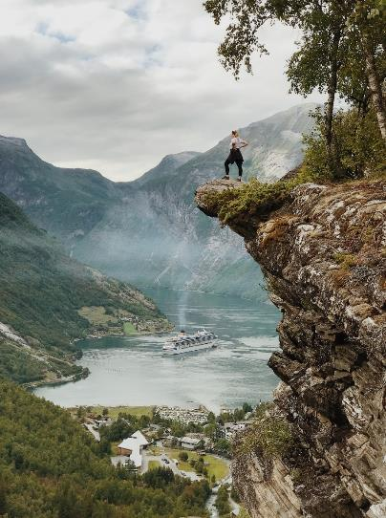
Own Your Journey
Play to YOUR Strengths!
Outsource Everything Else.
Activity: Identify Your Superpowers
If a manager asked what your three best attributes or skills were, what would you answer?
“He grokked that this was one of the critical cusps in the growth of a being wherein contemplation must bring forth right action in order to permit further growth. He acted.” ―Robert Heinlein, Stranger in a Strange Land
Photo by Julie Aagaard from Pexels

Slide 36
Map Superpowers to Services
Services​/Primary Work Activities | Importance / Urgency​ | Influence / Authority​ | Superpowers (strengths)​
Requirements Elicitation & Backlog Refinement | 2. Focus Time (High/Low) | Authority | Attention to detail
Process Mapping & Workflow Optimization | 3. Stretch Goals (Medium/All) | Authority | Attention to detail
Project Schedule, Milestones & Sprint Delivery | 2. Focus Time (High/Low) | Influence | Planning & sequencing
Risk, Assumptions, Issues & Dependencies (RAID) Management | 2. Focus Time (High/Low) | Influence | Attention to detail, Clear messaging
Stakeholder Engagement & Communication Cadence | 2. Focus Time (High/Low) | Influence | Clear messaging
User Acceptance Testing (UAT) & Solution Validation | 4. Automate, Delegate, Decline (Low/High) | Authority | Attention to detail
Triage, Production Support | 1. Emergency (High/High) | Influence | Grace under pressure
Change Management, Training & Handover Documentation | 3. Stretch Goals (Medium/All) | Influence | Clear messaging

Slide 37

Reduce Work In Progress
Work in progress has NO value!
Only delivered work has value.
Photo by Ali Pazani from Pexels

Slide 38

Origin of Kanban [ kahn-bahn ]
Kanban originated in the Lean Manufacturing process at Toyota Production Systems.
It is based on a signal board to quickly see and manage work items.
Kanban promotes several key principles, including:
  Pulling your next work item, not having it pushed to you.
  Finish tasks first, move work forward second, add new work last.
Photo by cottonbro studio from Pexels
Learn more at https://en.wikipedia.org/wiki/Kanban_(development)

Slide 39
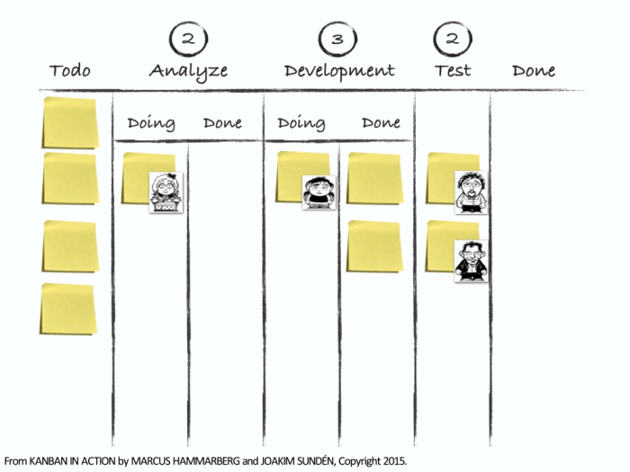
Kanban and Limiting Work In Progress (WIP)
Read/Work right to left.
Finish everything you can first.
Stop Starting. Start Finishing.
Only start new tasks when all other tasks are blocked.
Limit WIP per column to avoid switching costs.
Visualizing Workflows with WIP

Slide 40
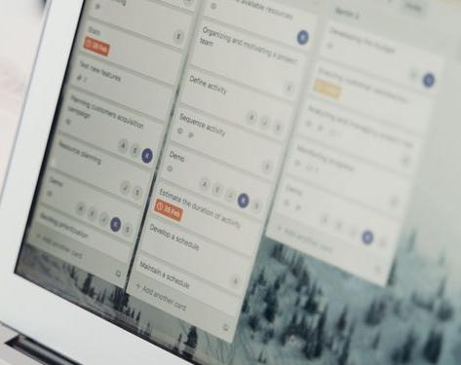
Kanban Basics
Requests
Changes
Defects
Prioritized Demand
To Do
Doing
Done
Work Sequencing
3
2
1
1
2
3
4
Photo by cottonbro studio from Pexels

Slide 41
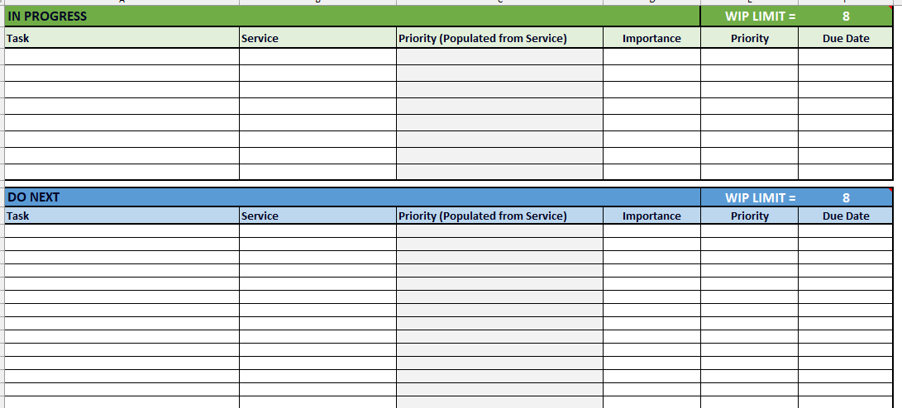
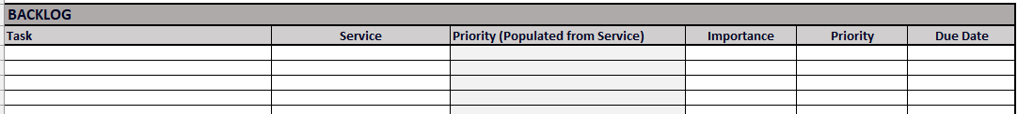
Build your Professional Service Kanban

Slide 42

Understanding Work In Progress
Place Order
(To Do)
Pay for Order
(Doing)
Pick Up Order
(Done)

Slide 43
Work In Progress – High WIP limit
Place Order
Pay for Order
Pick Up Order

Slide 44
Work In Progress – Low WIP limit
Place Order
Pay for Order
Pick Up Order

Slide 45
Work In Progress – Just right WIP
Place Order
Pay for Order
Pick Up Order

Slide 46
Professional Service Kanban – WIP Limits

Slide 47
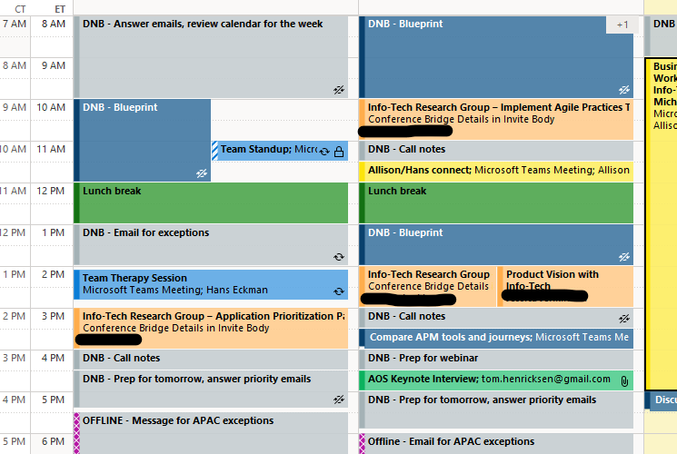
Timebox Your Tasks into Themes
Block out time for specific types of work or “focus time”.
Limit interruptions.
Move blocks, don’t delete them.

Slide 48
Activity: Capacity Planning
WEEKLY CAPACITY PLANNER
Total Working Hours | 40
Total Allocated Hours | 0
Available Time | 40
Non-Service Activities | Hours | Estimated2 | Notes
Administrative tasks |  | 1-5 hours/week (2-10%) | Expense reports, approvals, time tracking, HR tasks
Documentation |  | 2-8 hours/week (5-15%) | Creating, updating, and maintaining knowledge bases
Email and messaging |  | 5-15 hours/week (10-30%) | Reading, responding, triaging, Teams/Slack communication
Meetings |  | 5-20 hours/week (10-50%) | Status meetings, 1:1s, planning, reviews, coordination
Mentoring and coaching |  | 0-8 hours/week | Increases with seniority
Planning and prioritization |  | 1-4 hours/week (2-8%) | Weekly planning, roadmaps, task management
Process and compliance activities |  | 1-3 hours/week (2-5%) | Audits, quality reviews, governance requirements
Project coordination |  | 2-10 hours/week (5-20%) | Tracking dependencies, follow-ups, status reporting
Recruiting and interviewing |  | 0-5 hours/week average | More common for senior employees and managers
Stakeholder communication |  | 2-10 hours/week (5-20%) | Updates, presentations, customer/internal partner interactions
Training and learning |  | 1-4 hours/week (2-8%) | Required training, certifications, skill development
Breaking down the infinite workday, Microsoft, 17 JUN 2025
How work about work gets in the way of real work, Asana, 17 APR 2026

Slide 49

How are you going to fill your moments?
“There is only one time that is important -- Now!“
- Leo Tolstoy, What Men Live by and Other Tales
Photo by Jill Burrow from Pexels

Slide 50
Achieving More by Doing Less Workshop
EckmanGuides.com
Download the workshop materials:
Live polling: SLIDO.COM
Event code: ###
Scan the QR code.

Slide 51
Services​/Primary Work Activities​ | Importance / Urgency​ | Influence / Authority​ | Superpowers (strengths)​

Slide 52
Setting Priorities: Modified Eisenhower Matrix
High
2. FOCUS TIME Most Productive Use Of Time AI-Assisted/Paired Development (High ROI) | 1. Emergency Fix It Now! Plan Better. AI-Assisted (Unnecessary Expense)
3. Stretch Goals Good Enough Delivery. Time/Scope Box Automate and AI-Outsource Core Tasks (Low ROI)
Nope FUN, But Just Say NO! Not Productive (Negative ROI) | 4. AUTOMATE, DELEGATE, Or DECLINE Time Wasters (Negative ROI)
IMPORTANCE
Low
High
URGENCY

Slide 53
IN PROGRESS |  |  |  | WIP LIMIT =
Task | Service​/Work Activity | Priority (Populated from Service) | Importance | Priority | Due Date
DO NEXT |  |  |  | WIP LIMIT =
Task | Service​/Work Activity | Priority (Populated from Service) | Importance | Priority | Due Date

Slide 54
BACKLOG
Task | Service​/Work Activity | Priority (Populated from Service) | Importance | Priority | Due Date

Slide 55
WEEKLY CAPACITY PLANNER
Total Working Hours | 40
Total Allocated Hours | 0
Available Time | 40
Services​/Primary Work Activities​ | Allocated Hours | Estimated2 | Notes

Slide 56
WEEKLY CAPACITY PLANNER
Total Working Hours | 40
Total Allocated Hours | 0
Available Time | 40
Non-Service Activities | Allocated Hours | Estimated2 | Notes
Administrative tasks |  | 1-5 hours/week (2-10%) | Expense reports, approvals, time tracking, HR tasks
Documentation |  | 2-8 hours/week (5-15%) | Creating, updating, and maintaining knowledge bases
Email and messaging |  | 5-15 hours/week (10-30%) | Reading, responding, triaging, Teams/Slack communication
Meetings |  | 5-20 hours/week (10-50%) | Status meetings, 1:1s, planning, reviews, coordination
Mentoring and coaching |  | 0-8 hours/week | Increases with seniority
Planning and prioritization |  | 1-4 hours/week (2-8%) | Weekly planning, roadmaps, task management
Process and compliance activities |  | 1-3 hours/week (2-5%) | Audits, quality reviews, governance requirements
Project coordination |  | 2-10 hours/week (5-20%) | Tracking dependencies, follow-ups, status reporting
Recruiting and interviewing |  | 0-5 hours/week average | More common for senior employees and managers
Stakeholder communication |  | 2-10 hours/week (5-20%) | Updates, presentations, customer/internal partner interactions
Training and learning |  | 1-4 hours/week (2-8%) | Required training, certifications, skill development

